Slide 1
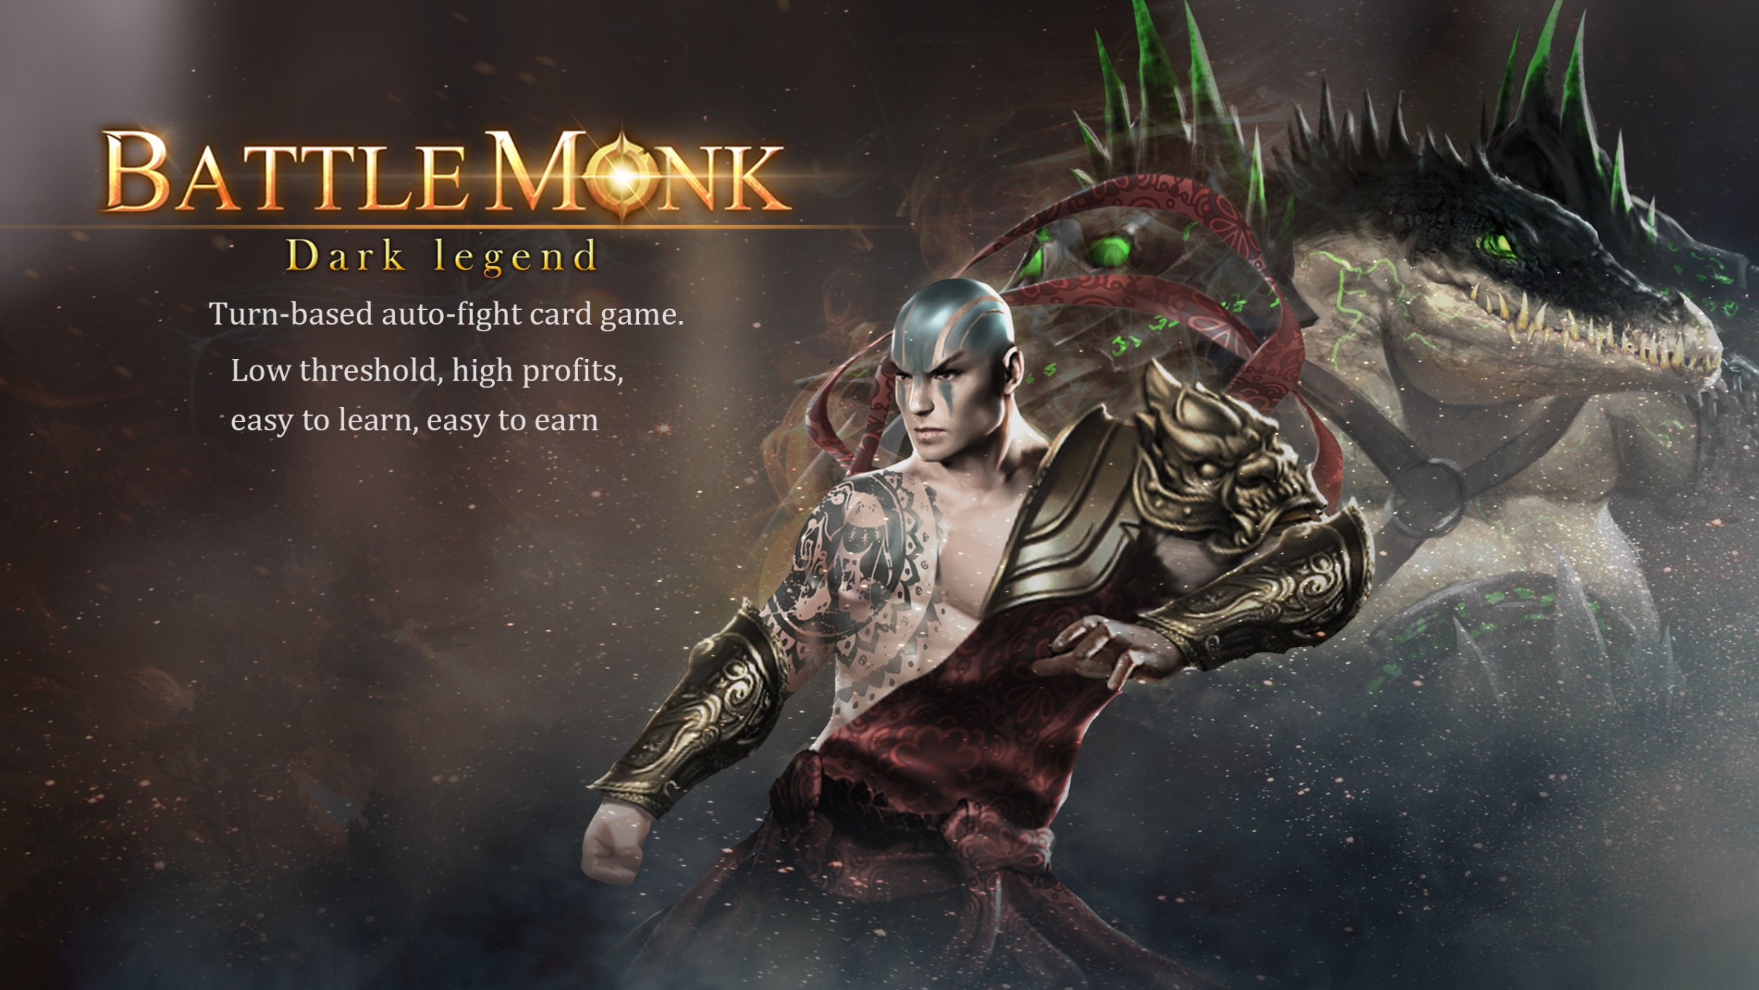
Turn-based auto-fight card game.
Low threshold, high profits, easy to learn, easy to earn.

Slide 2
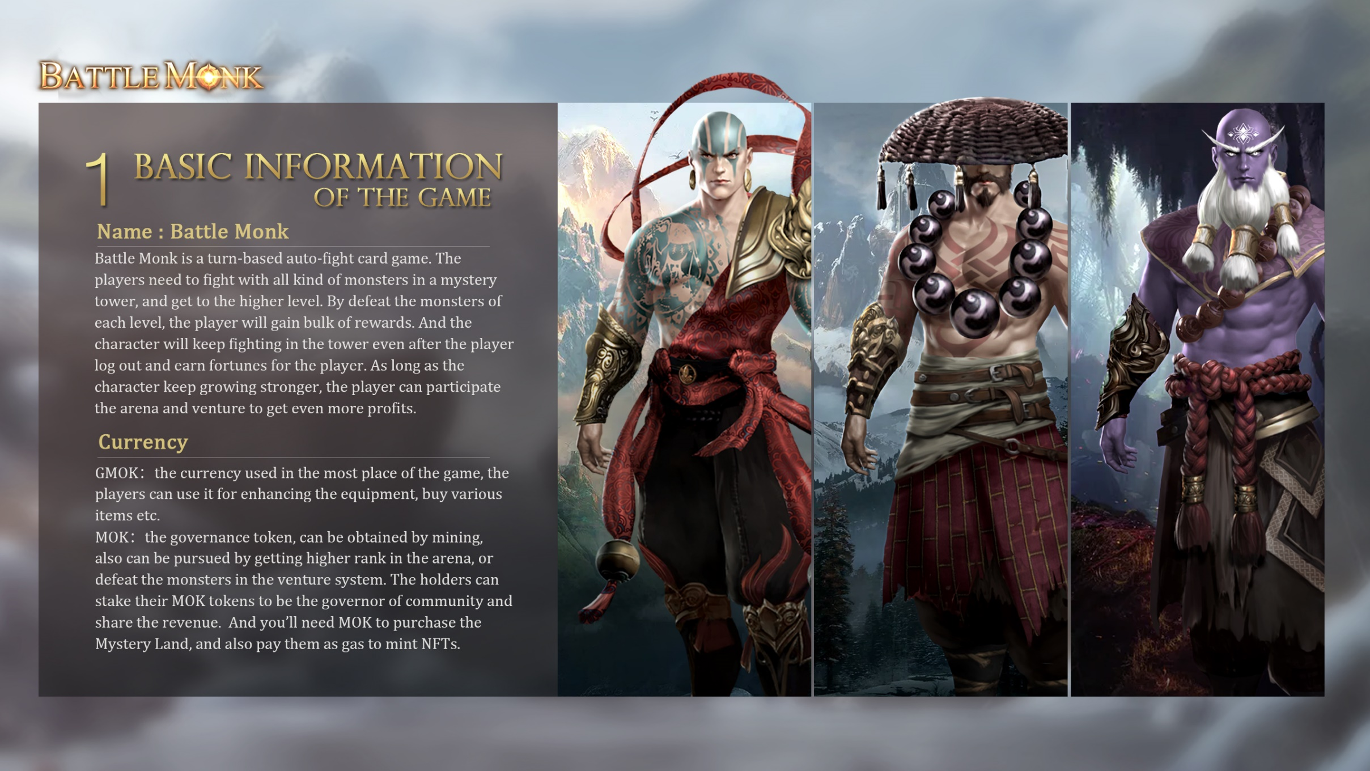
1.BASICS FOR THE GAME
Game’s name : Battle Monk
Battle Monk is a turn-based auto-fight card game. The players need to fight with all kinds of monsters in a mystery tower, and get to the higher level. By defeat the monsters of each level, the player will gain bulk of rewards. And the character will keep fighting in the tower even after the player log out and earn fortunes for the player. As long as the character keep growing stronger, the player can participate the arena and venture to get even more profits.
Currency Unit
GMOK：The currency used in the most places of the game, the players can use it for enhancing the equipment, buy various items etc.
MOK：The governance token, can be obtained by mining, also can be pursued by getting higher rank in the arena, or defeat the monsters in the venture system. The holders can stake their MOKs to be the governor of community and share the revenue. And you’ll need MOKs to purchase the Mystery Land, and also pay them as gas to mint NFTs.

Slide 3
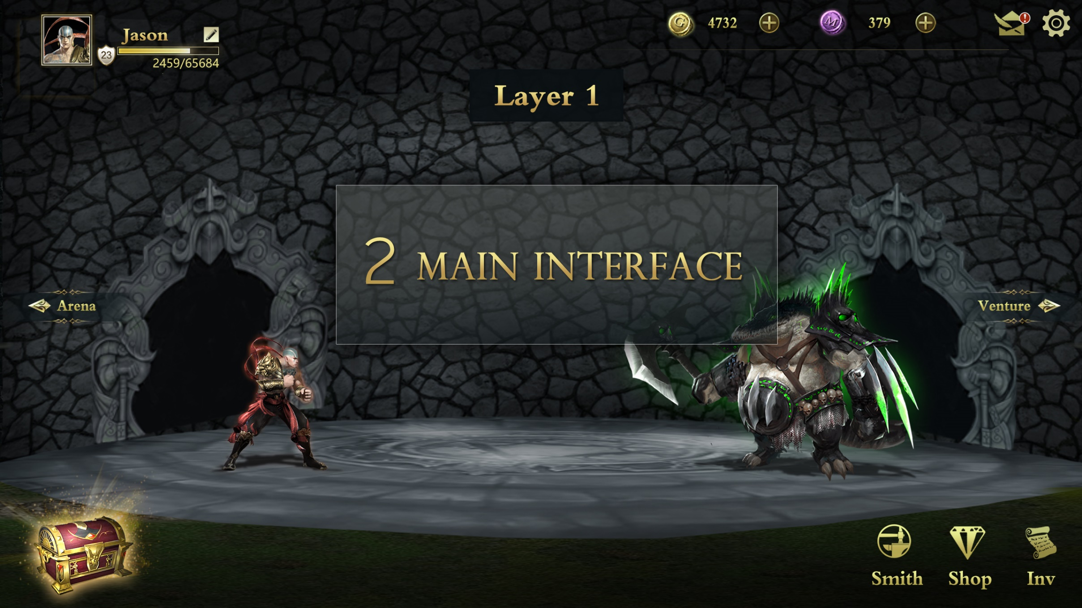
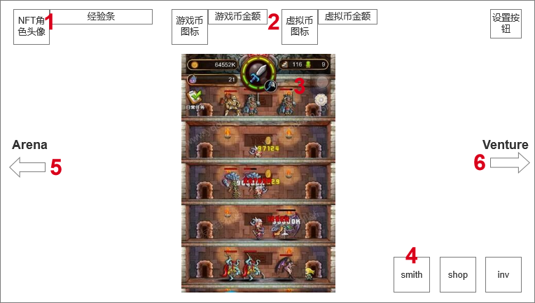
2.主界面（缺图）

Slide 4
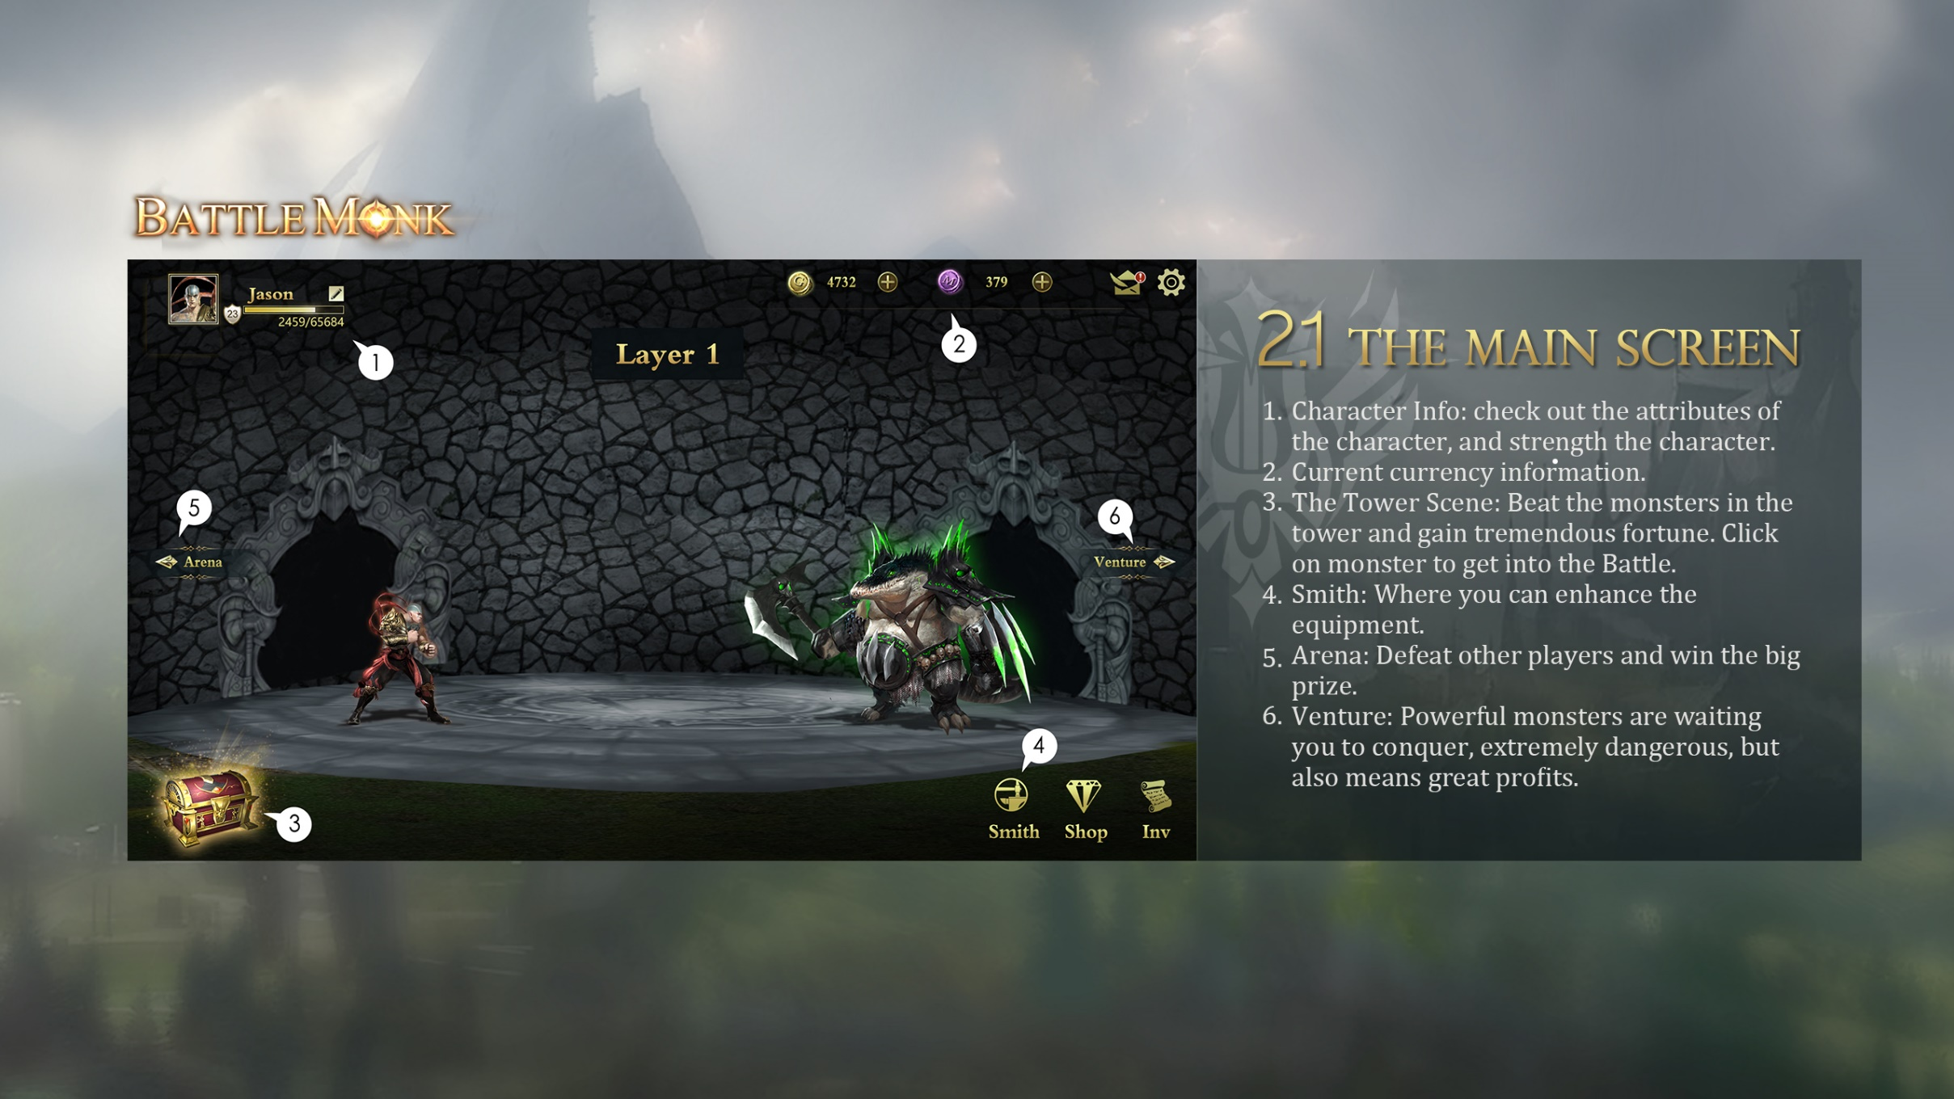
2.1 THE MAIN SCREEN
Character Info: check out the attributes of the character, and strength the character.
Current currency information.
The Tower Scene: Beat the monsters in the tower and gain tremendous fortune. Click on monster to get into the Battle.
Smith: Where you can enhance the equipment.
Arena: Defeat other players and win the big prize.
Venture: Powerful monsters are waiting you to conquer, extremely dangerous, but also means great profits.

Slide 5
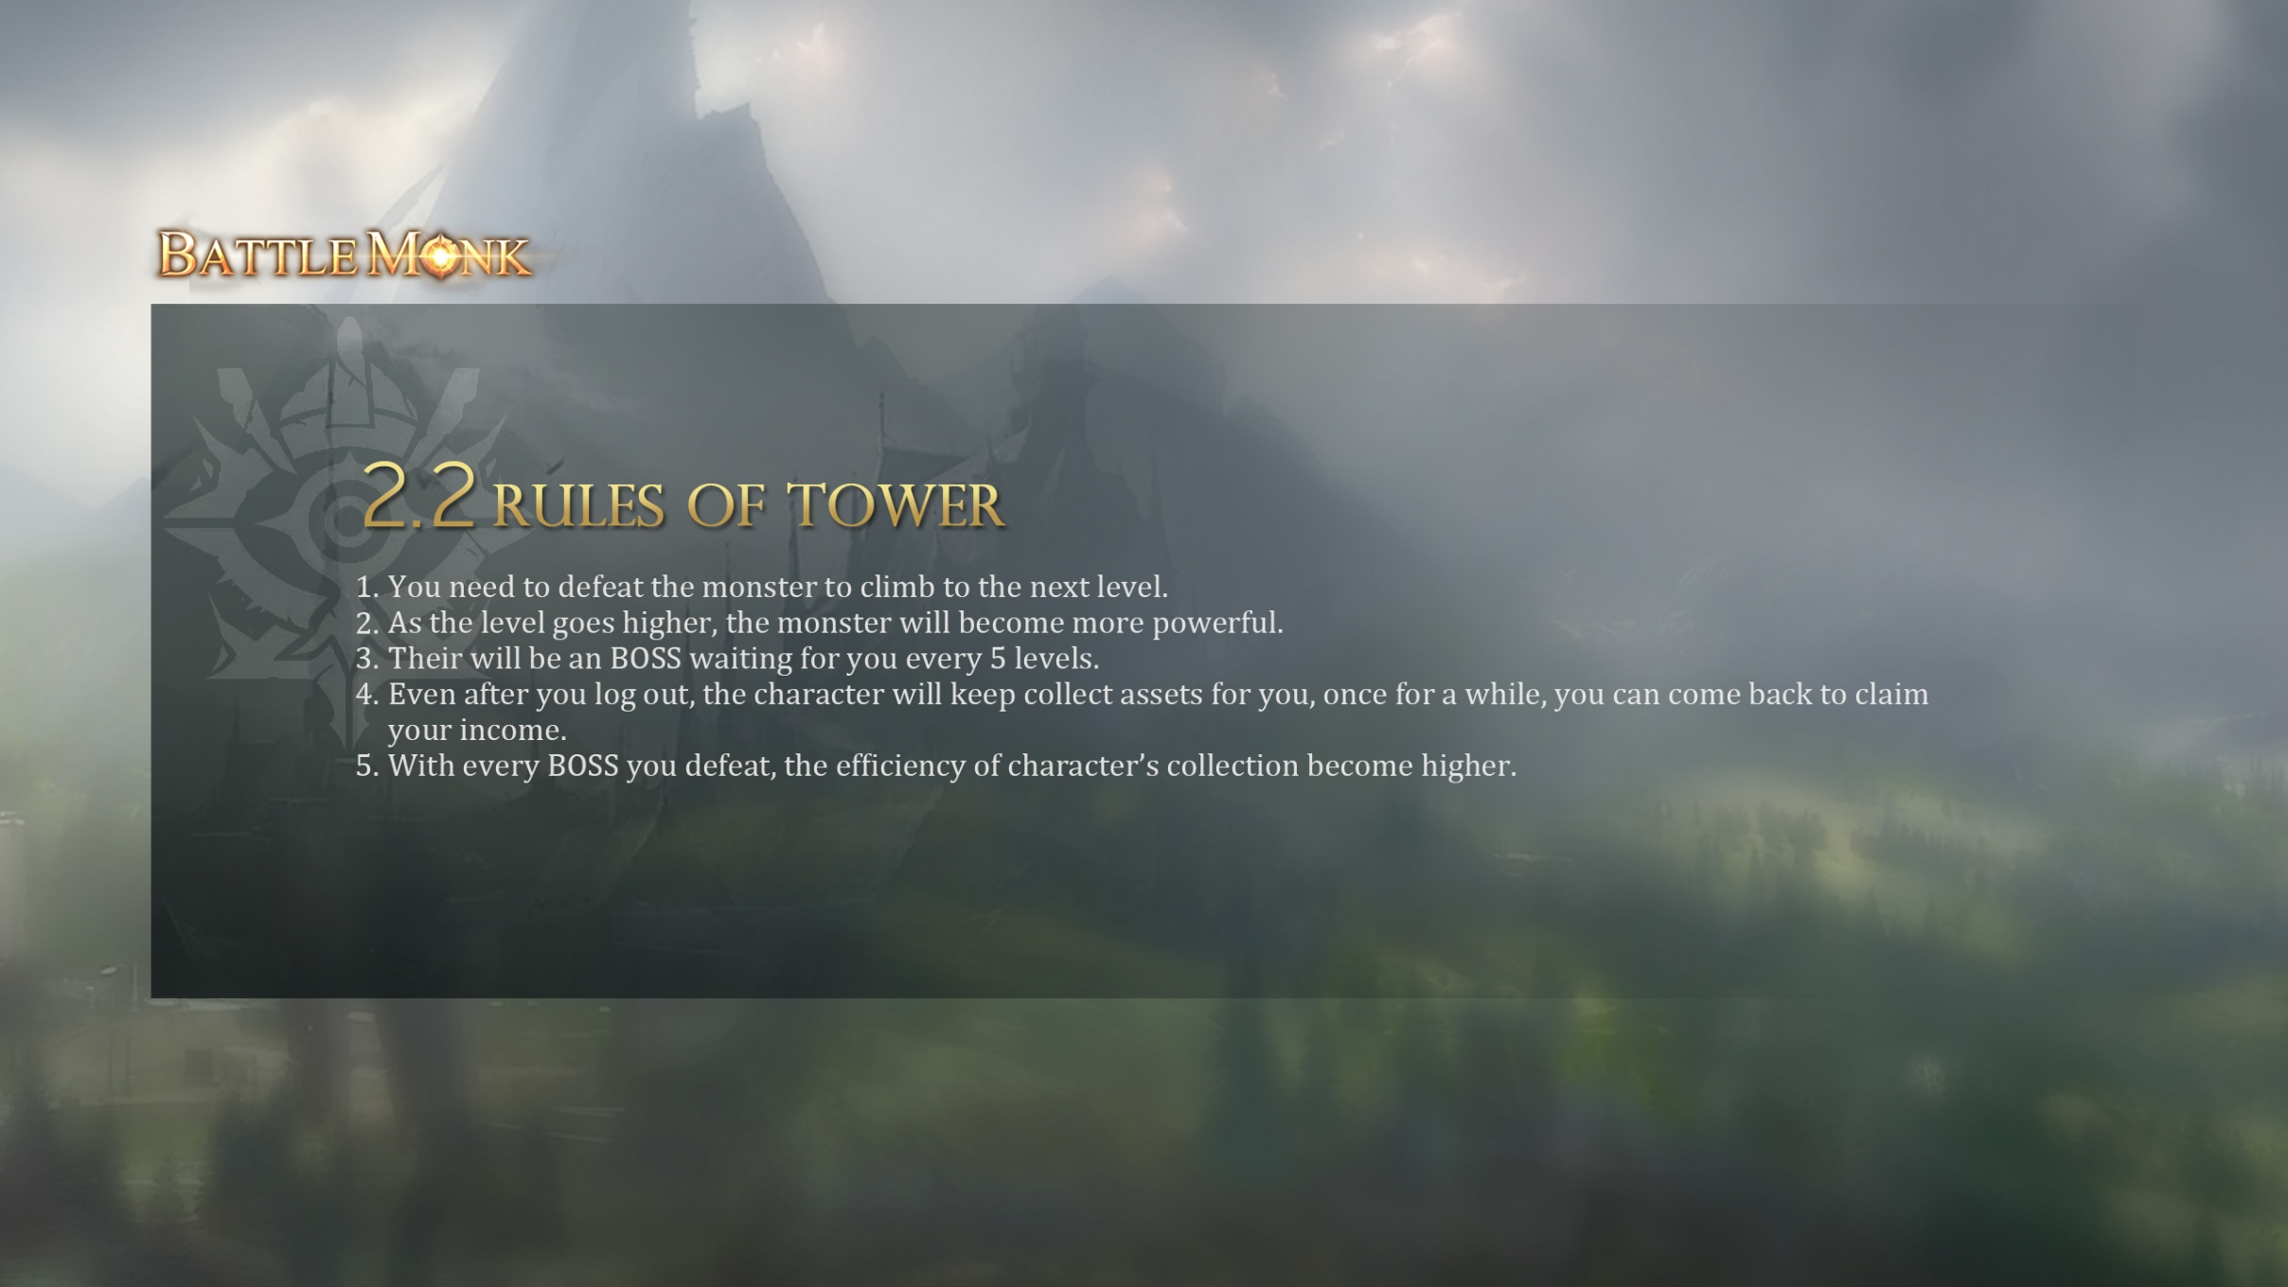
2.2 Rules of Tower
You need to defeat the monster to climb to the next level.
As the level goes higher, the monster will become more powerful.
Their will be an BOSS waiting for you every 5 levels.
Even after you log out, the character will keep collect assets for you, once for a while, you can come back to claim your income.
With every BOSS you defeat, the efficiency of character’s collection become higher.

Slide 6
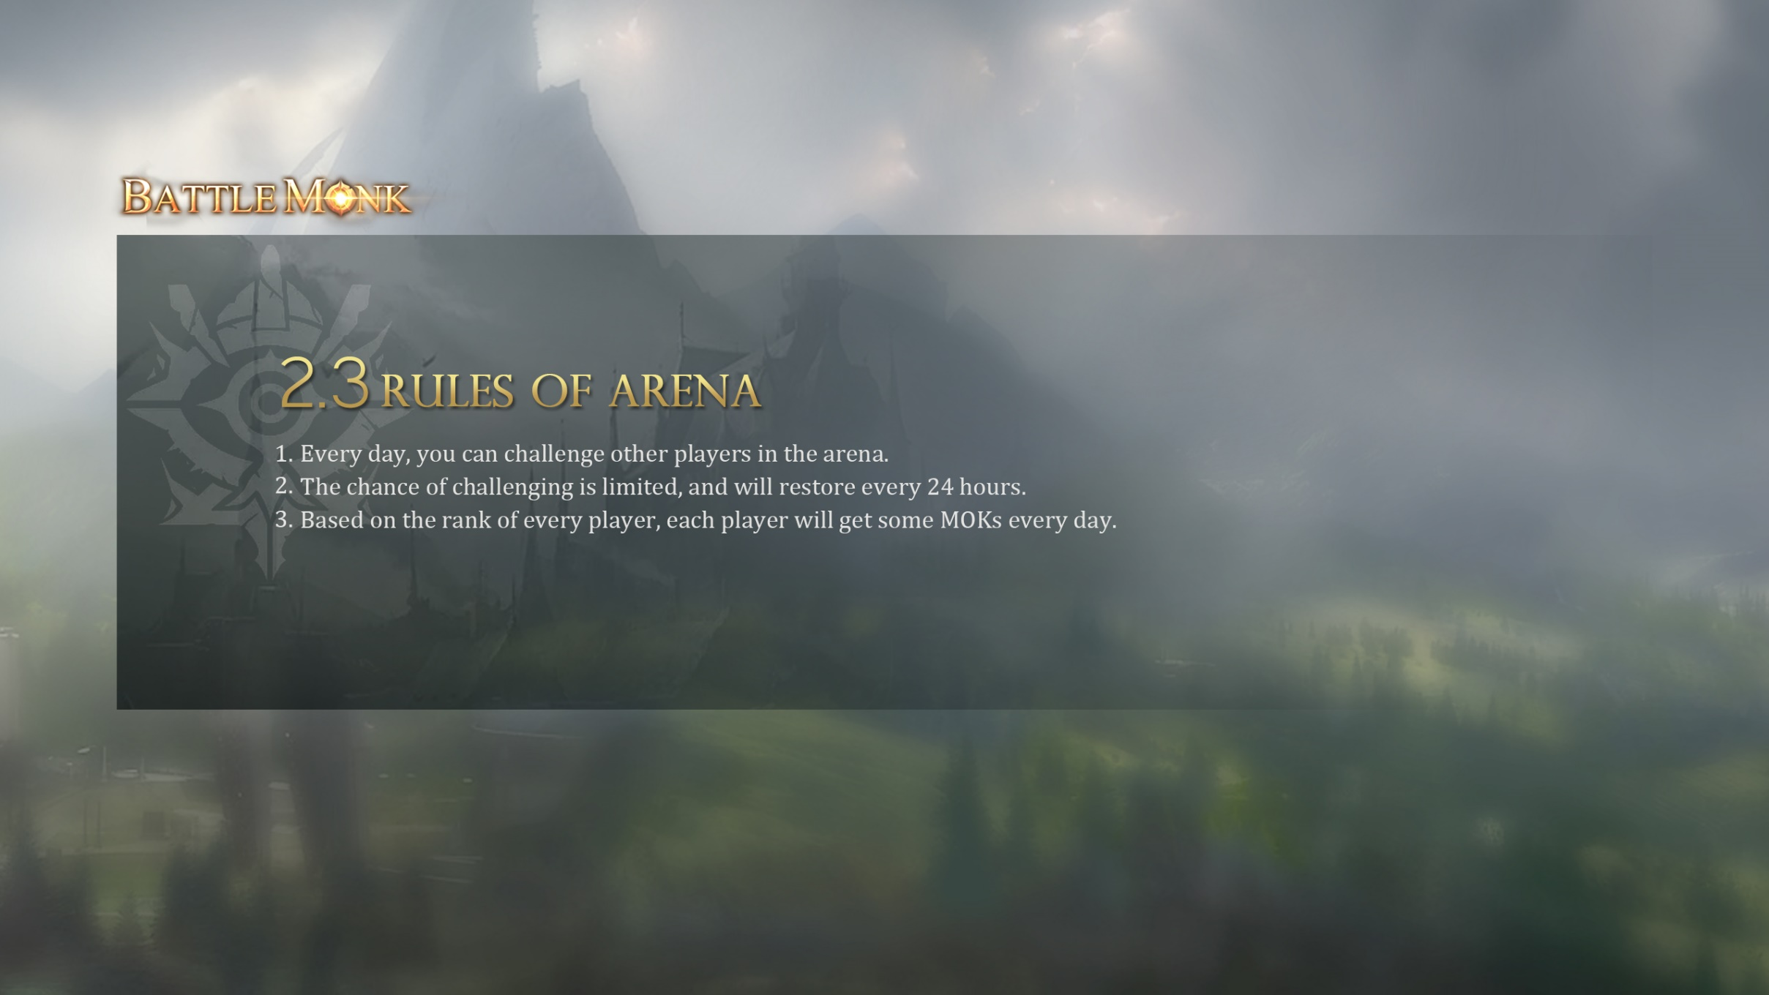
2.3 Rules of Arena
Every day, you can challenge other players in the arena.
The chance of challenging is limited, and will restore every 24 hours.
Based on the rank of every player, each player will get some MOKs every day.

Slide 7
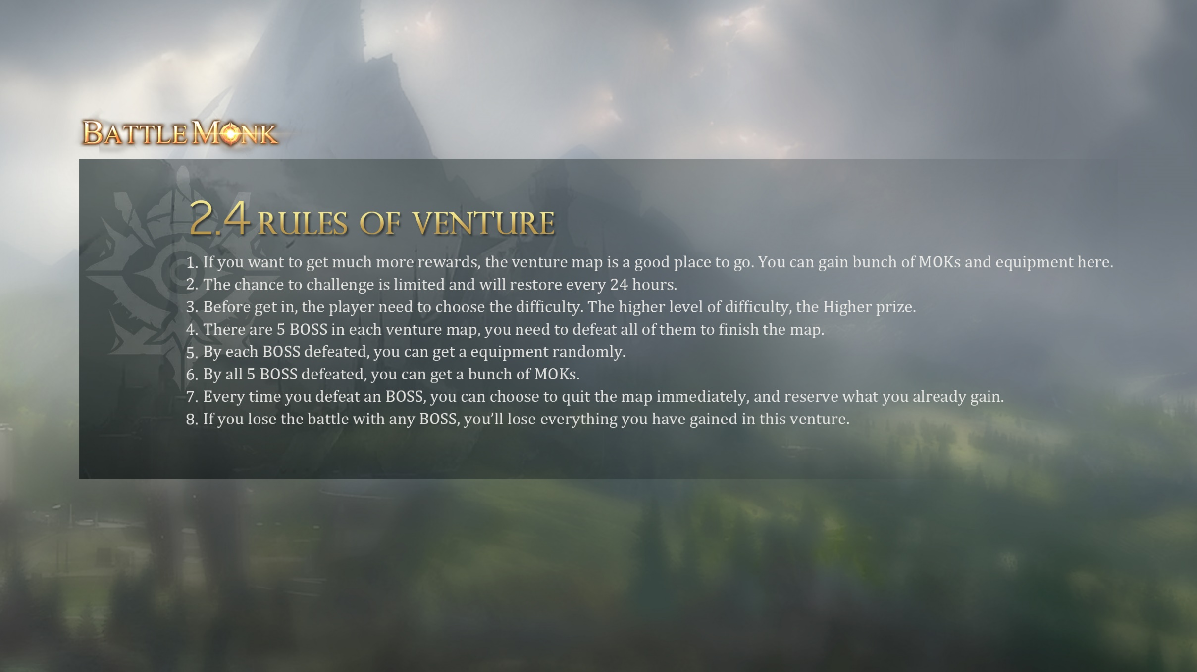
2.4 Rules of Venture
If you want to get much more rewards, the venture map is a good place to go. You can gain bunch of MOKs and equipment here.
The chance to challenge is limited and will restore every 24 hours.
Before get in, the player need to choose the difficulty. The higher level of difficulty, the Higher prize.
There are 5 BOSS in each venture map, you need to defeat all of them to finish the map.
By each BOSS defeated, you can get a equipment randomly.
By all 5 BOSS defeated, you can get a bunch of MOKs.
Every time you defeat an BOSS, you can choose to quit the map immediately, and reserve what you already gain.
If you lose the battle with any BOSS, you’ll lose everything you have gained in this venture.

Slide 8
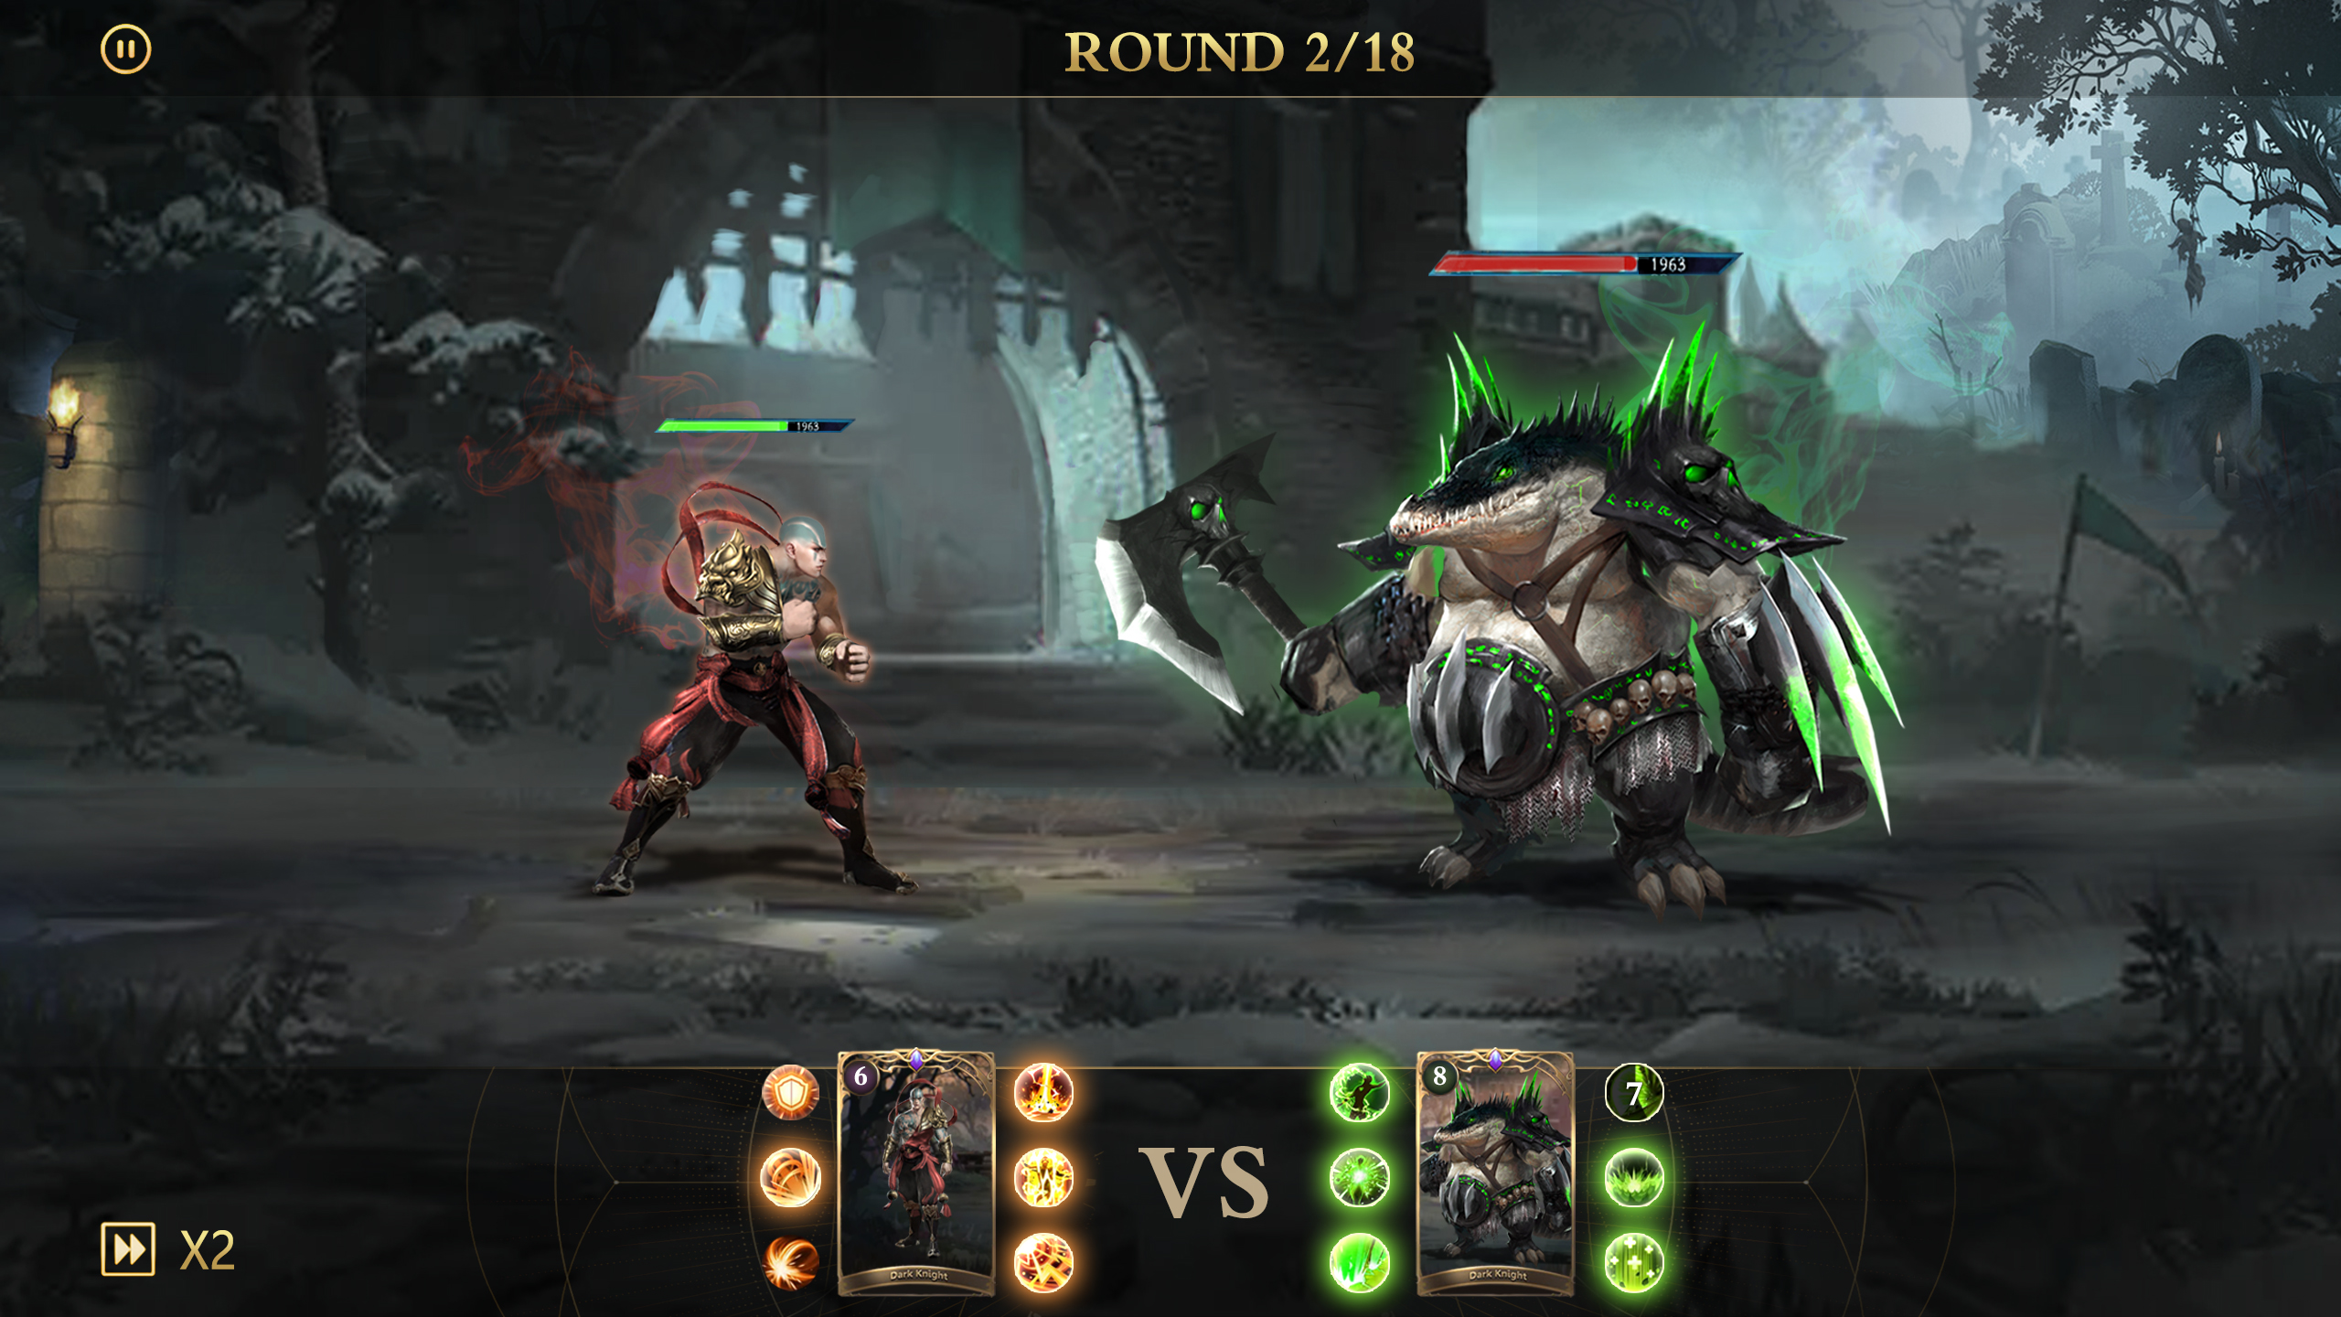
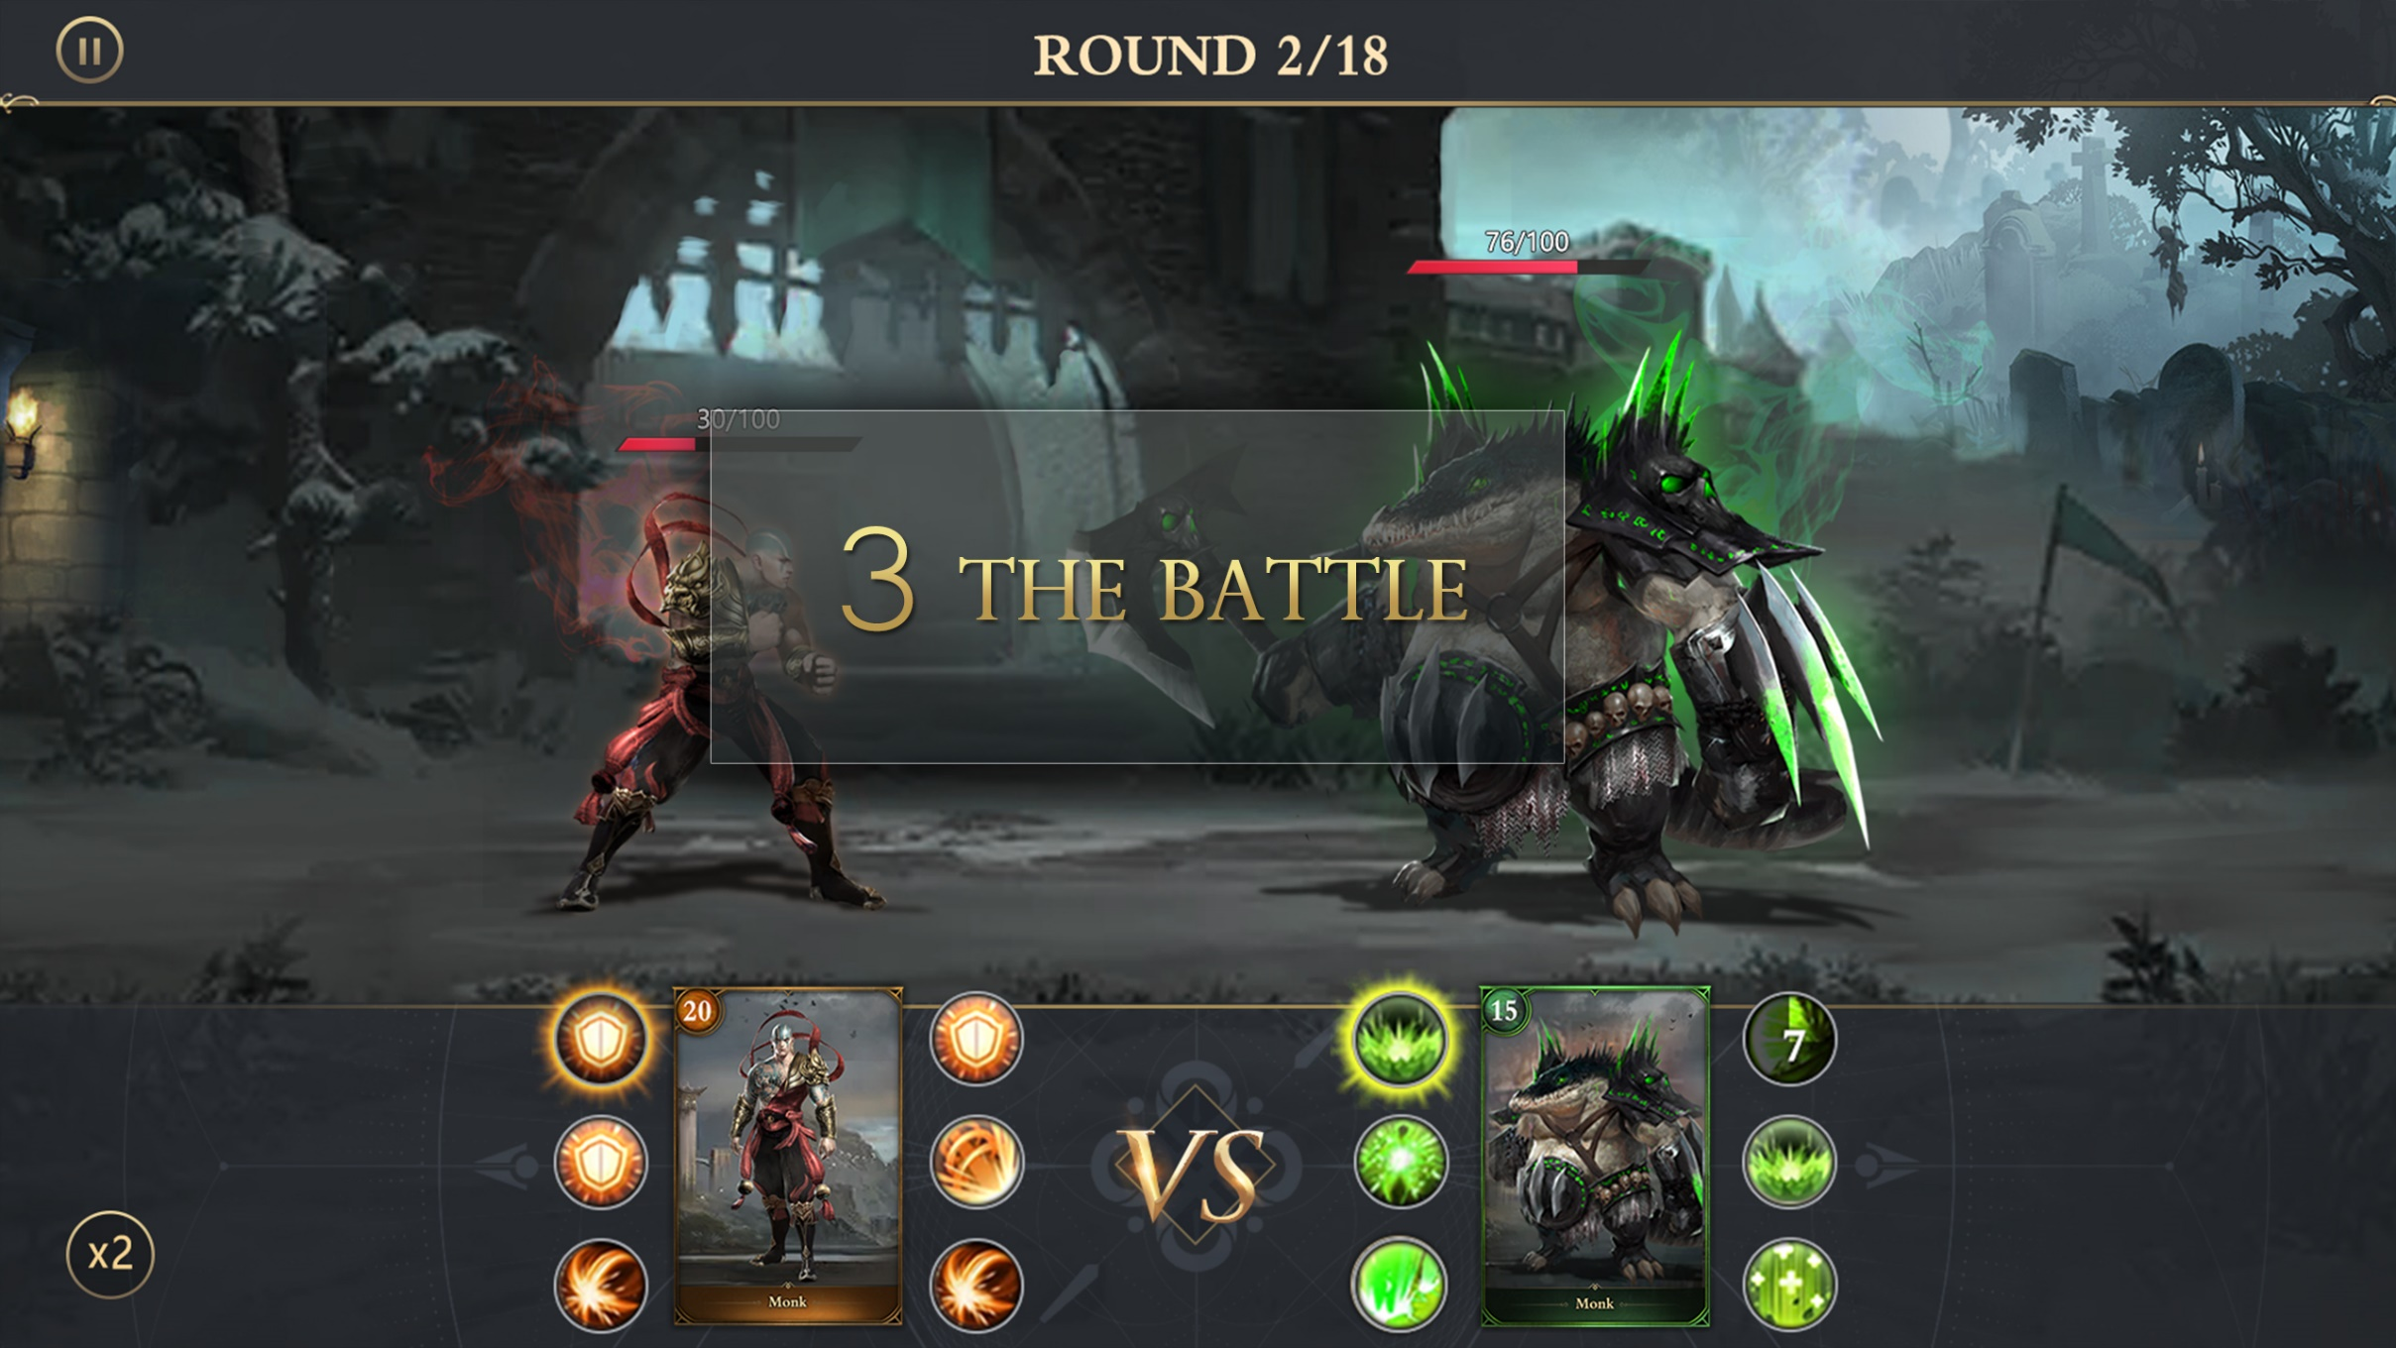

Slide 9
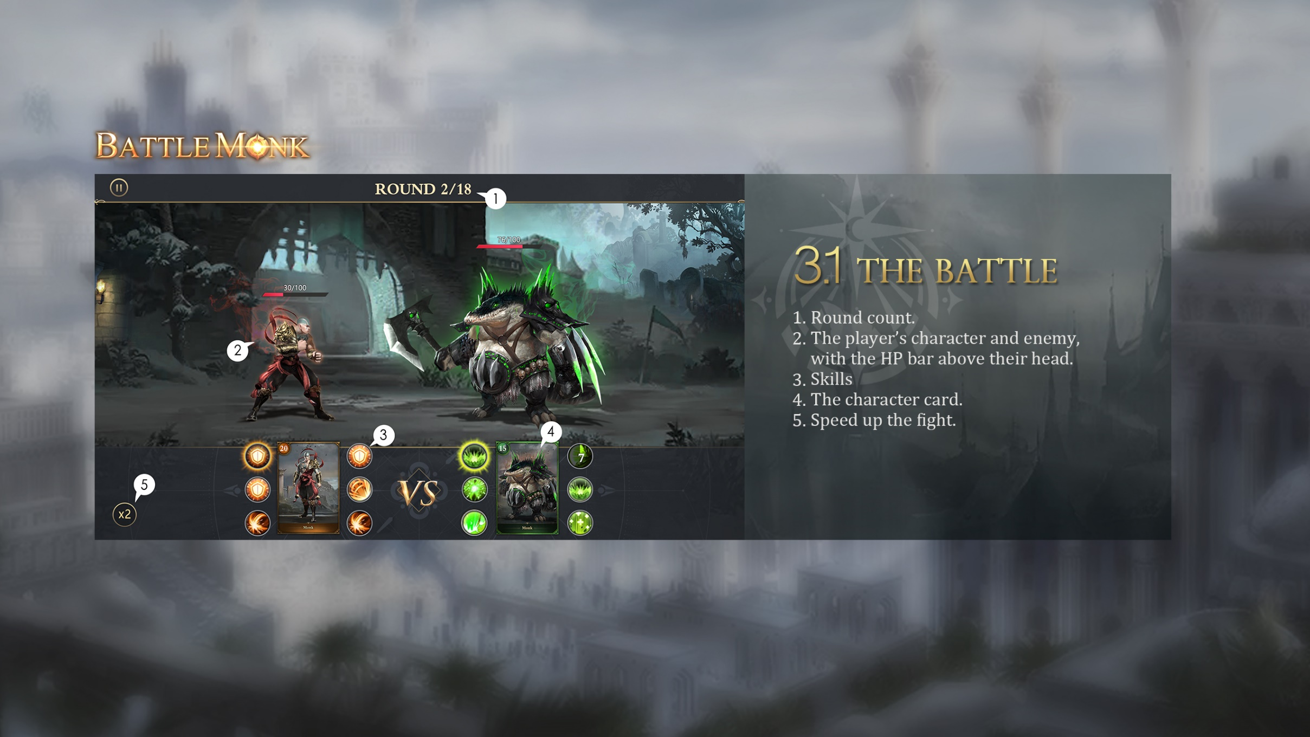
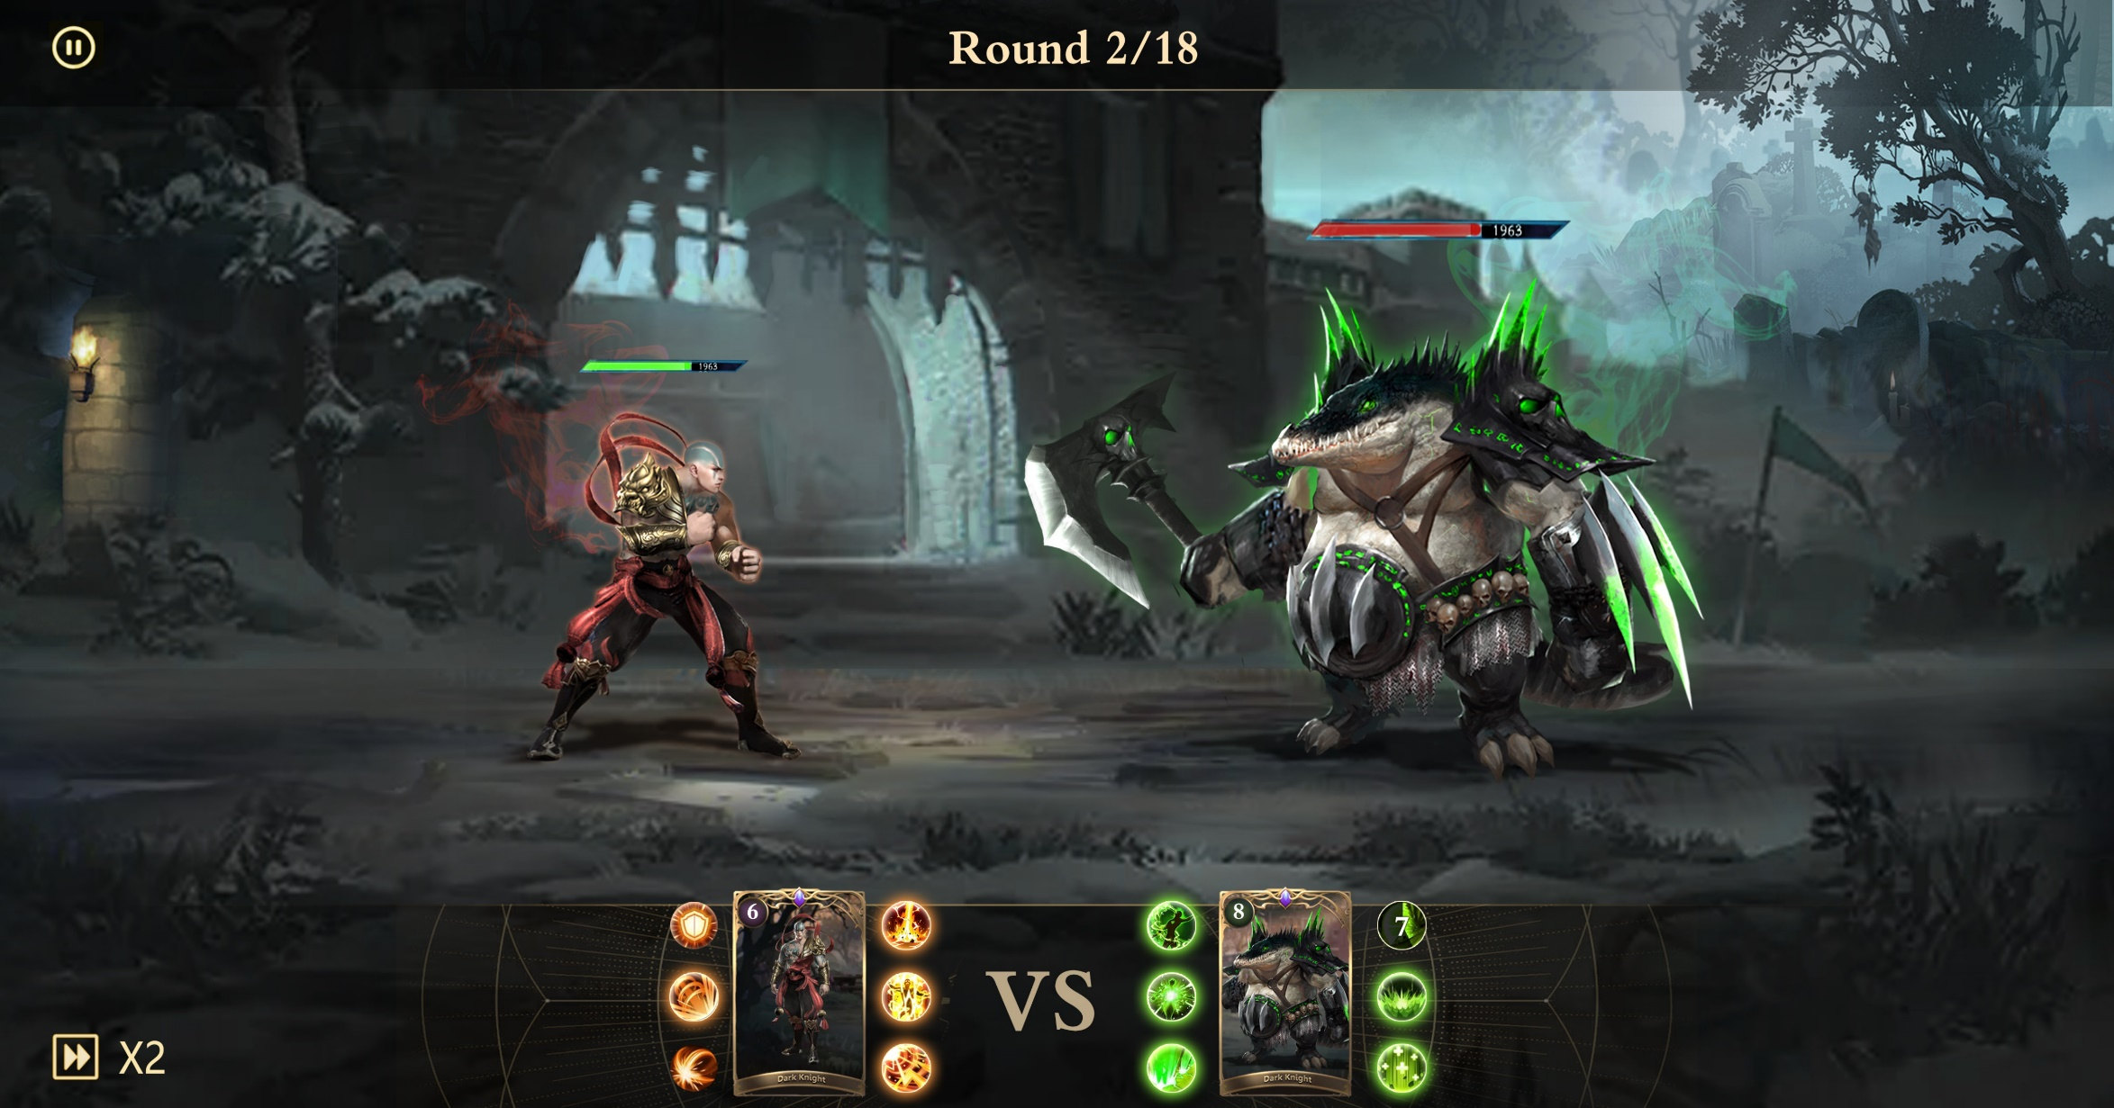
3.1 The Battle
1
Round count.
The player’s character and enemy, with the HP bar above their head.
Skills
The character card.
Speed up the fight.
2
4
5
3

Slide 10
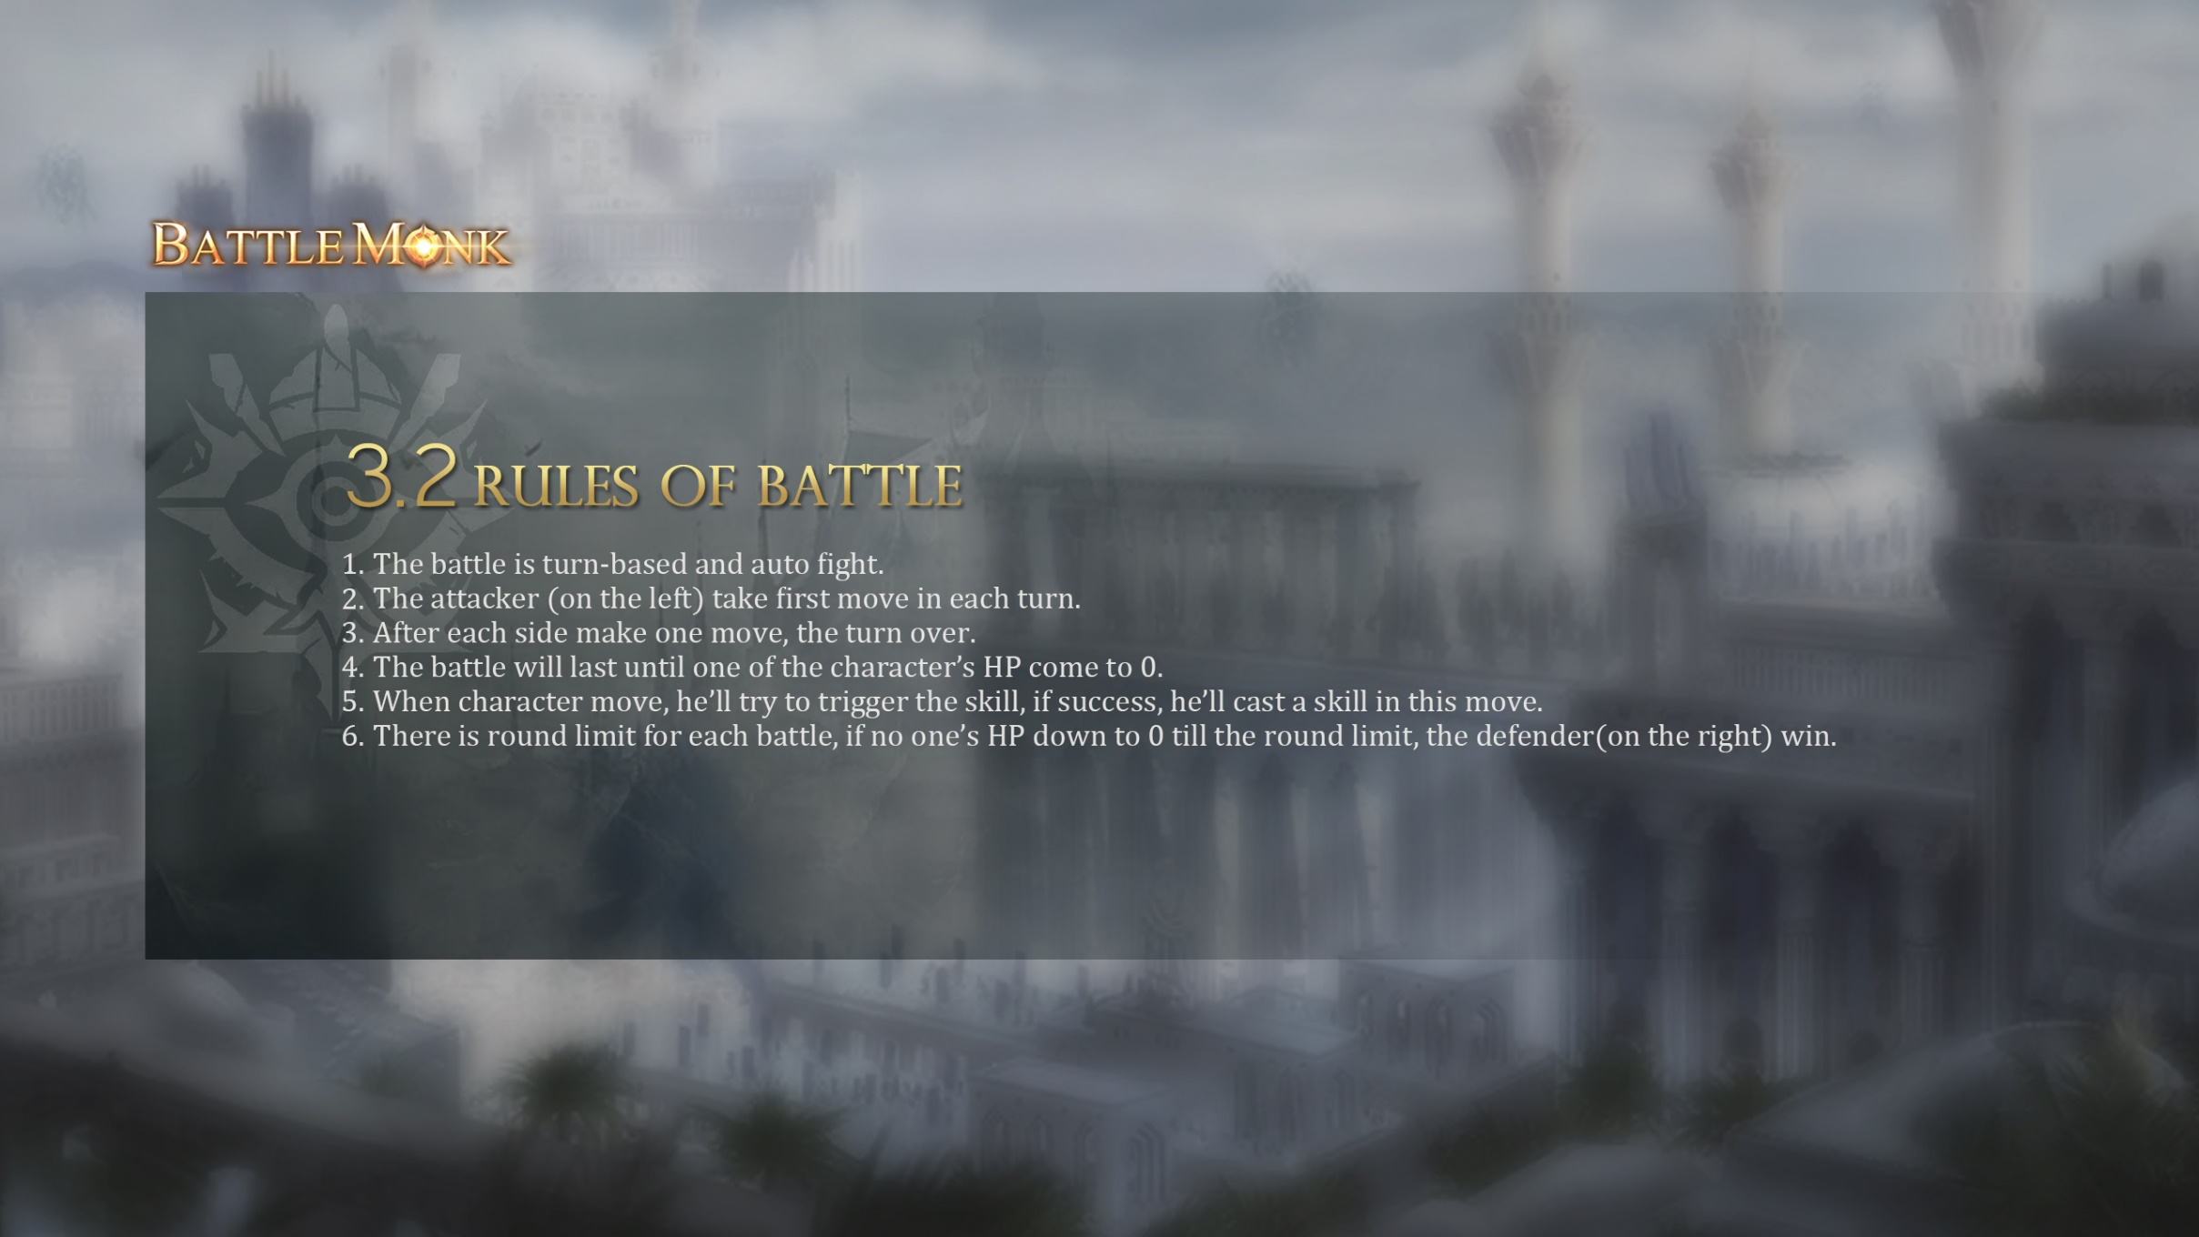
3.2 Rules of Battle
The battle is turn-based and auto fight.
The attacker (on the left) take first move in each turn.
After each side make one move, the turn over.
The battle will last until one of the character’s HP come to 0.
When character move, he’ll try to trigger the skill, if success, he’ll cast a skill in this move.
There is round limit for each battle, if no one’s HP down to 0 till the round limit, the defender(on the right) win.

Slide 11
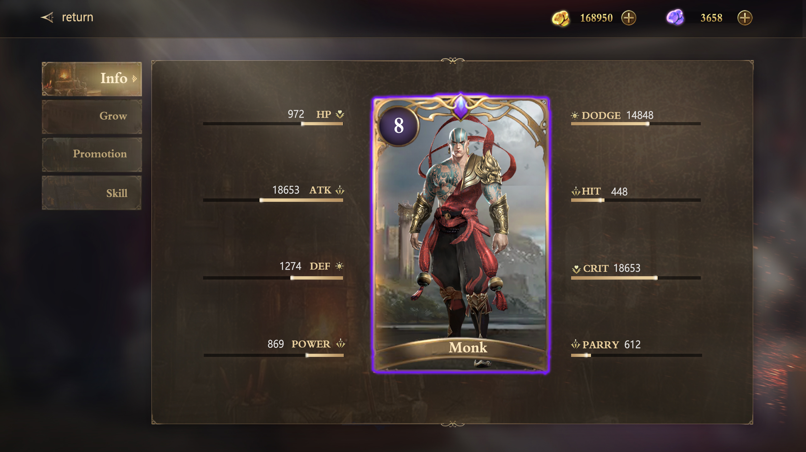
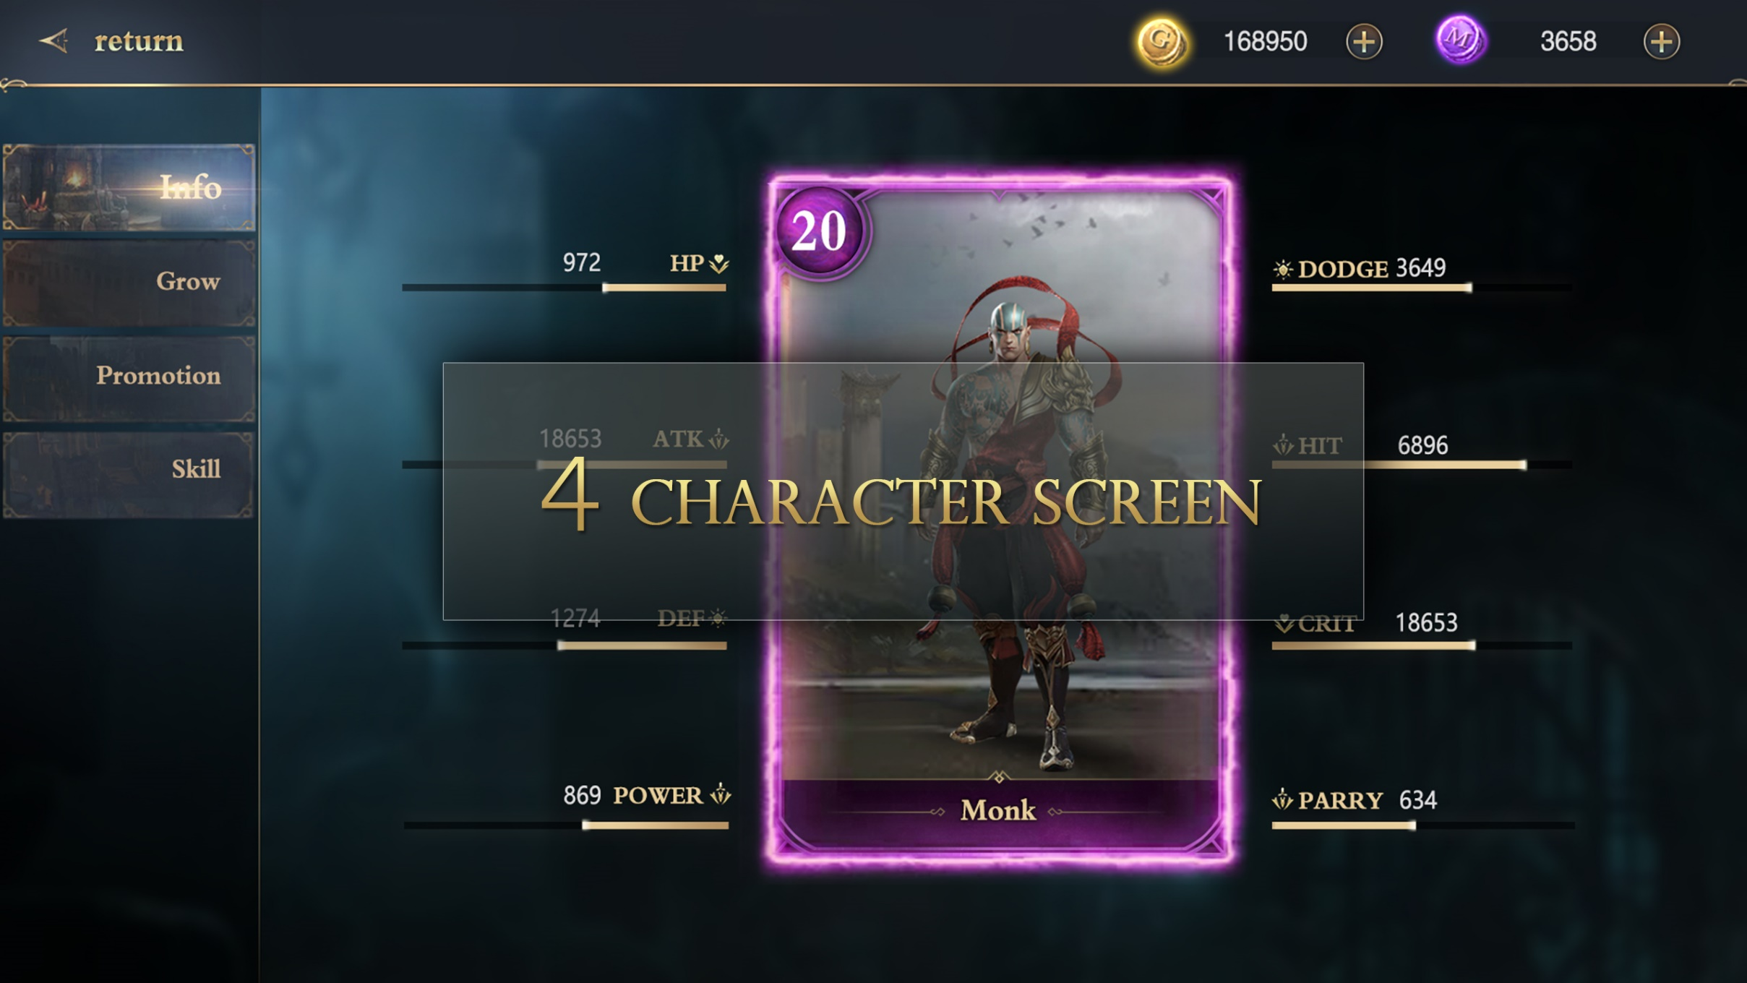
4.角色界面

Slide 12
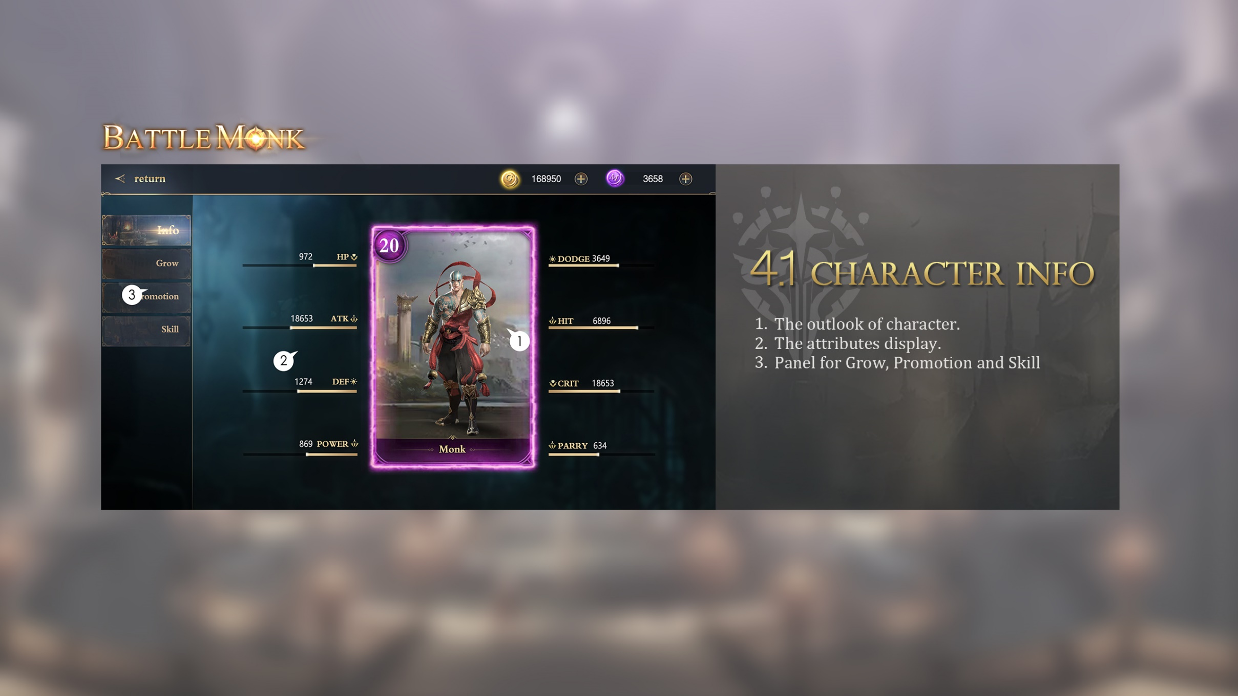

4.1 Character Info
The outlook of character.
The attributes display.
Panel for Grow, Promotion and Skill
3
2
1

Slide 13
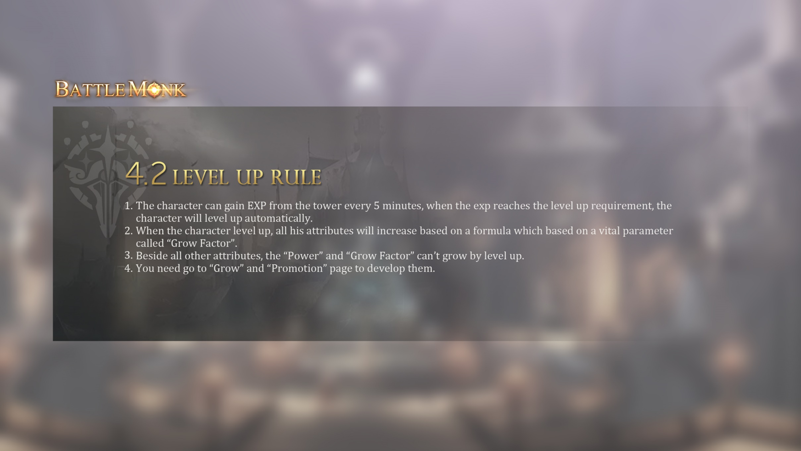
4.2 Level Up Rule
The character can gain EXP from the tower every 5 minutes, when the exp reaches the level up requirement, the character will level up automatically.
When the character level up, all his attributes will increase based on a formula which based on a vital parameter called “Grow Factor”.
Beside all other attributes, the “Power” and “Grow Factor” can’t grow by level up.
You need go to “Grow” and “Promotion” page to develop them.

Slide 14
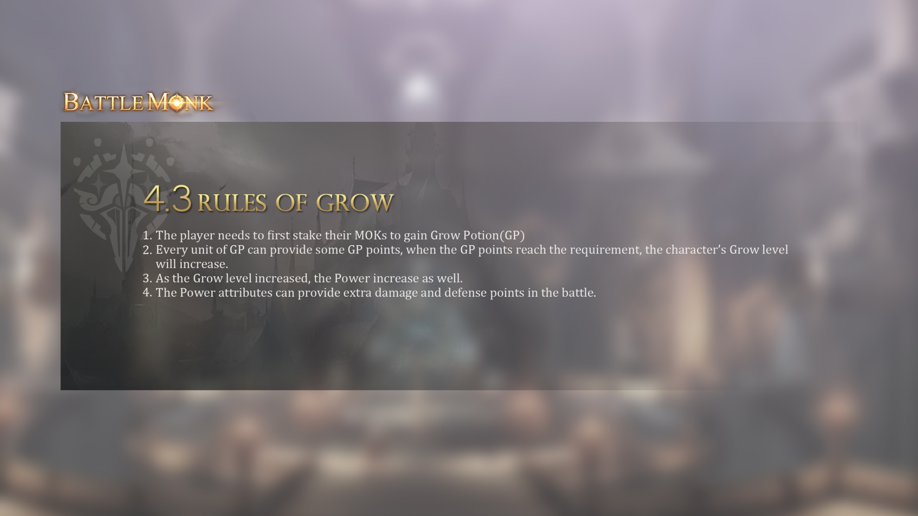
4.3 Rules of Grow
The player needs to first stake their MOKs to gain Grow Potion(GP)
Every unit of GP can provide some GP points, when the GP points reach the requirement, the character’s Grow level will increase.
As the Grow level increased, the Power increase as well.
The Power attributes can provide extra damage and defense points in the battle.

Slide 15
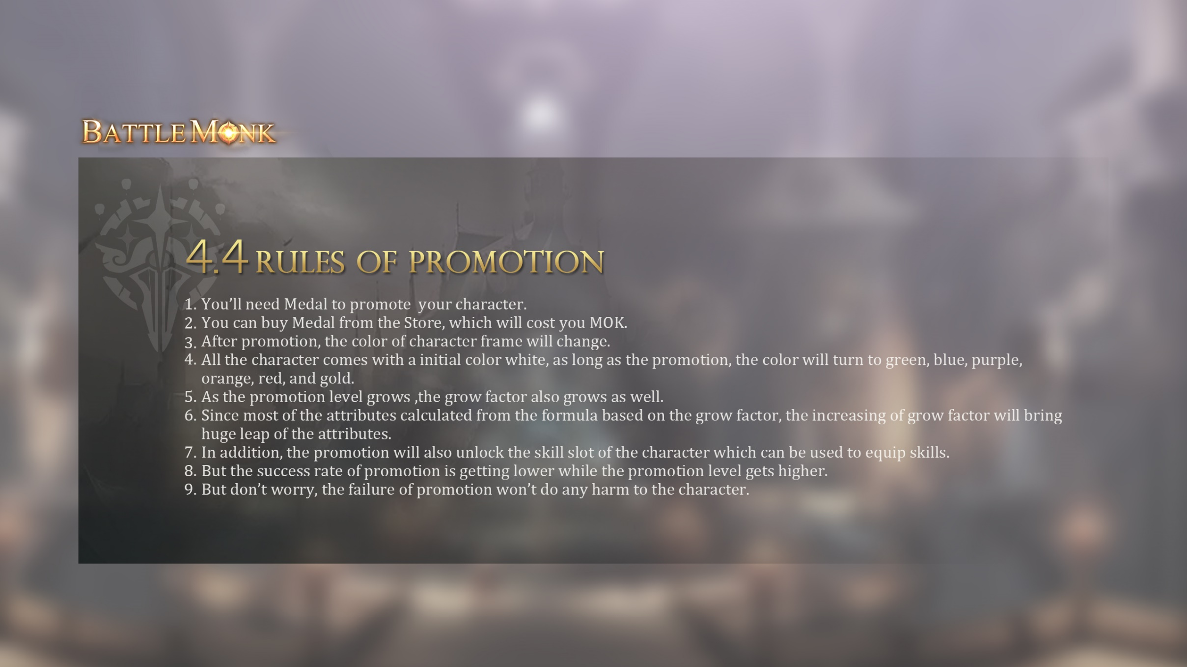
4.4 Rules of Promotion
You’ll need Medal to promote your character.
You can buy Medal from the Store, which will cost you MOK.
After promotion, the color of character frame will change.
All the character comes with a initial color white, as long as the promotion, the color will turn to green, blue, purple, orange, red, and gold.
As the promotion level grows ,the grow factor also grows as well.
Since most of the attributes calculated from the formula based on the grow factor, the increasing of grow factor will bring huge leap of the attributes.
In addition, the promotion will also unlock the skill slot of the character which can be used to equip skills.
But the success rate of promotion is getting lower while the promotion level gets higher.
But don’t worry, the failure of promotion won’t do any harm to the character.

Slide 16
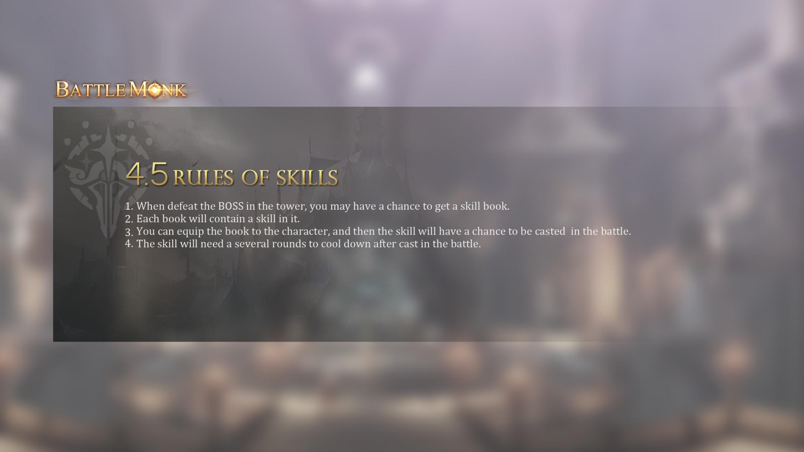
4.5 Rules of Skills
When defeat the BOSS in the tower, you may have a chance to get a skill book.
Each book will contain a skill in it.
You can equip the book to the character, and then the skill will have a chance to be casted in the battle.
The skill will need a several rounds to cool down after cast in the battle.

Slide 17
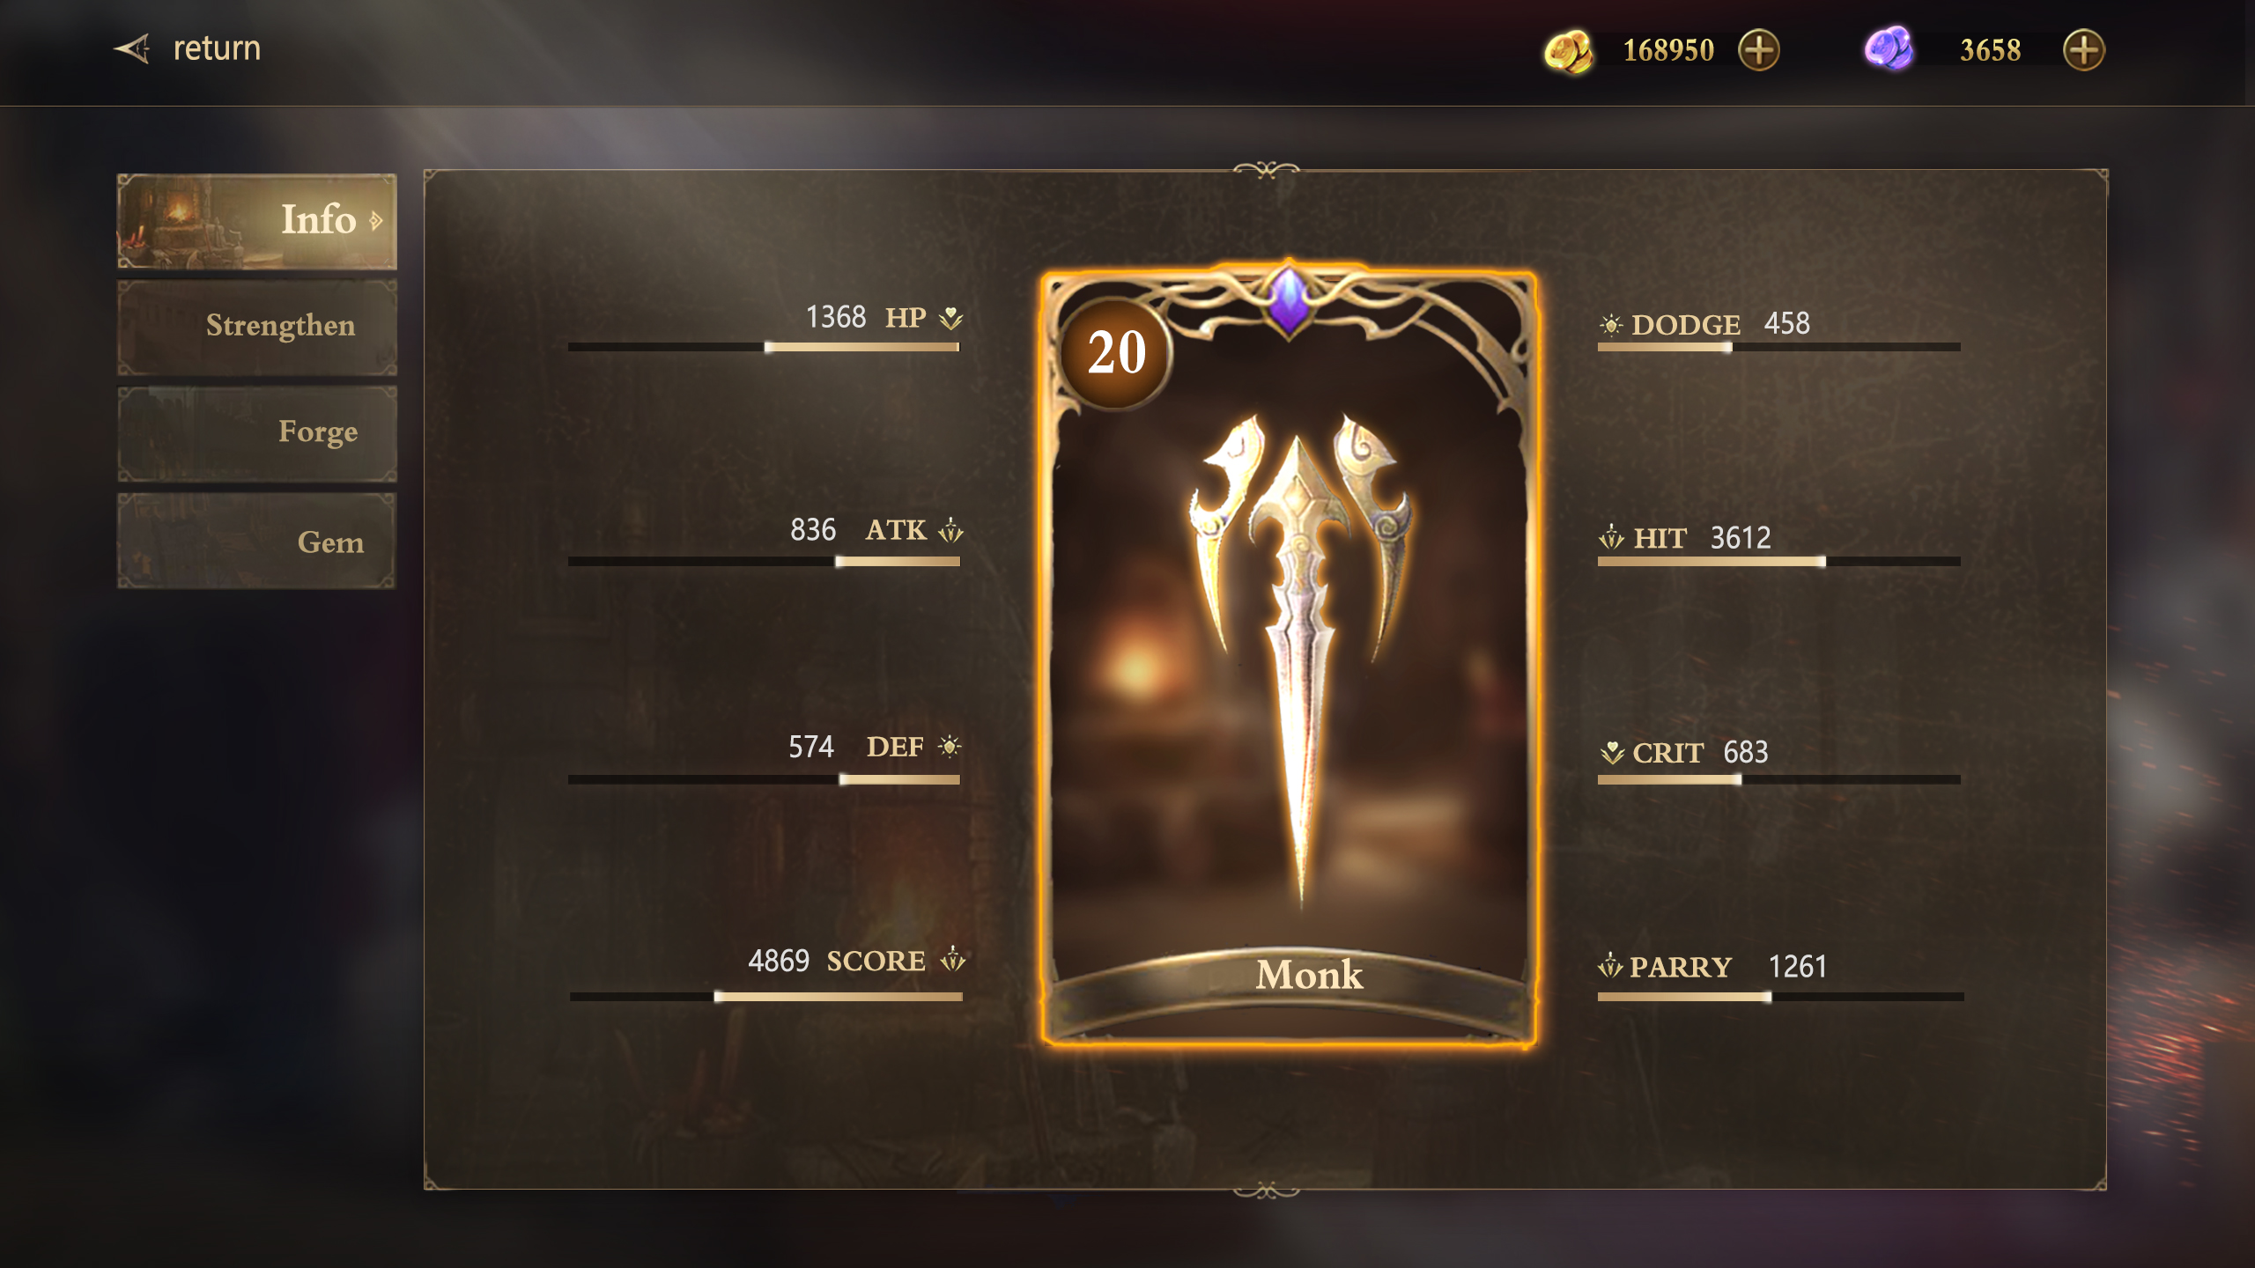
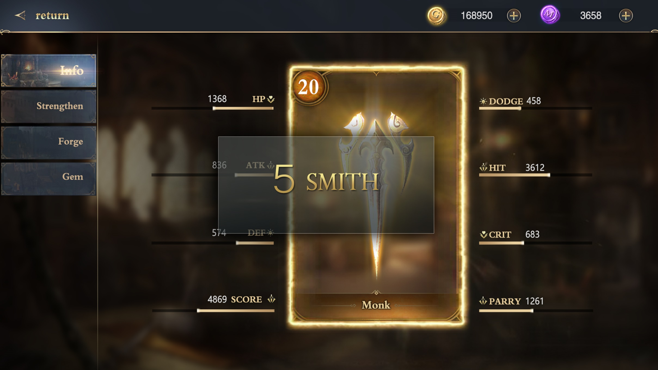
5.铁匠铺

Slide 18
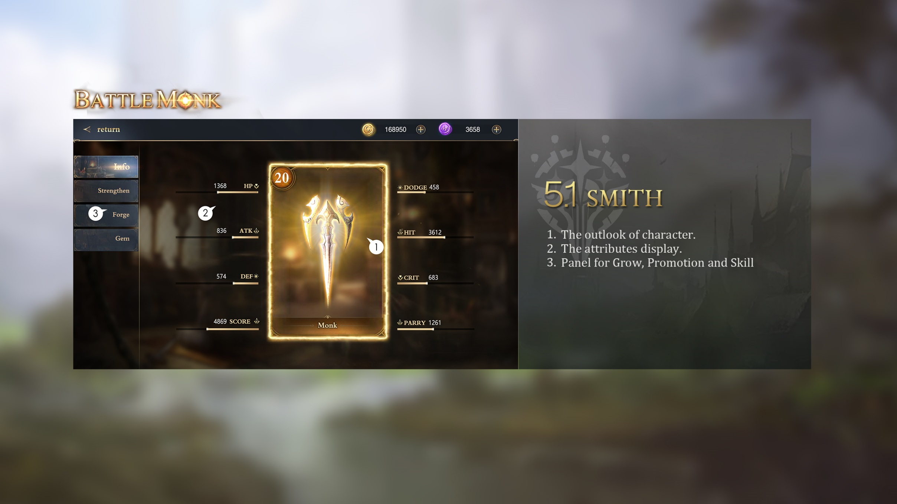
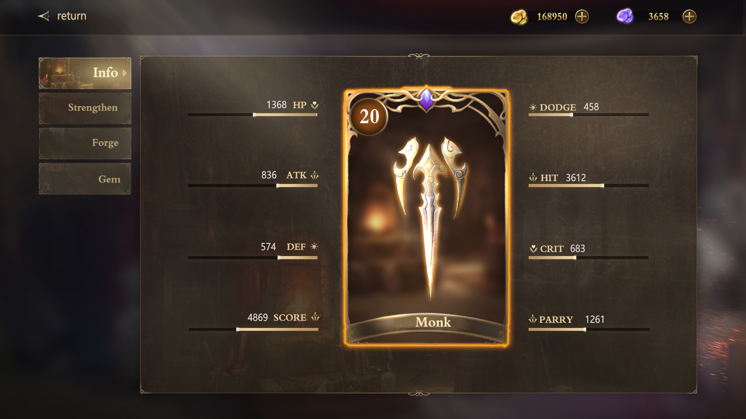
5.1 Smith
The outlook of equipment.
The attributes display.
Panel for Strengthen, Forge and Gem.
3
2
1

Slide 19
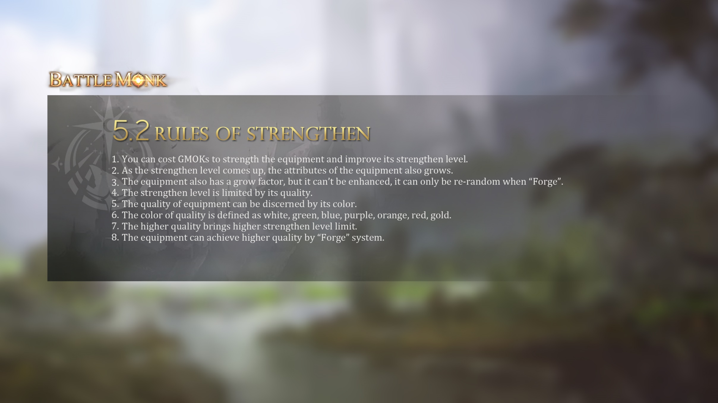
5.2 Rules of Strengthen
You can cost GMOKs to strength the equipment and improve its strengthen level.
As the strengthen level comes up, the attributes of the equipment also grows.
The equipment also has a grow factor, but it can’t be enhanced, it can only be re-random when “Forge”.
The strengthen level is limited by its quality.
The quality of equipment can be discerned by its color.
The color of quality is defined as white, green, blue, purple, orange, red, gold.
The higher quality brings higher strengthen level limit.
The equipment can achieve higher quality by “Forge” system.

Slide 20
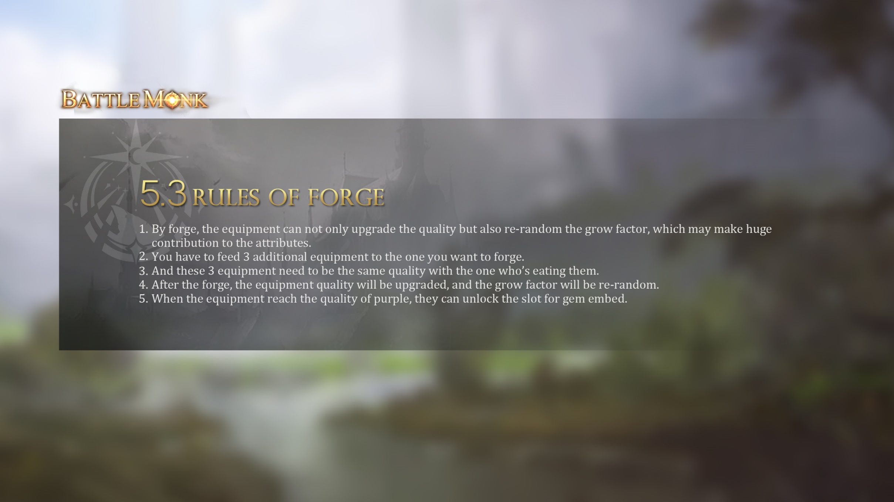
5.3 Rules of Forge
By forge, the equipment can not only upgrade the quality but also re-random the grow factor, which may make huge contribution to the attributes.
You have to feed 3 additional equipment to the one you want to forge.
And these 3 equipment need to be the same quality with the one who’s eating them.
After the forge, the equipment quality will be upgraded, and the grow factor will be re-random.
When the equipment reach the quality of purple, they can unlock the slot for gem embed.

Slide 21
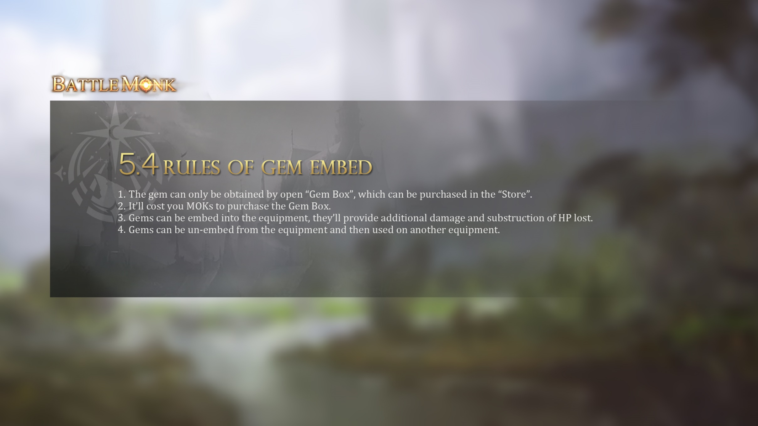
5.4 Rules of Gem embed
The gem can only be obtained by open “Gem Box”, which can be purchased in the “Store”.
It’ll cost you MOKs to purchase the Gem Box.
Gems can be embed into the equipment, they’ll provide additional damage and substruction of HP lost.
Gems can be un-embed from the equipment and then used on another equipment.

Slide 22
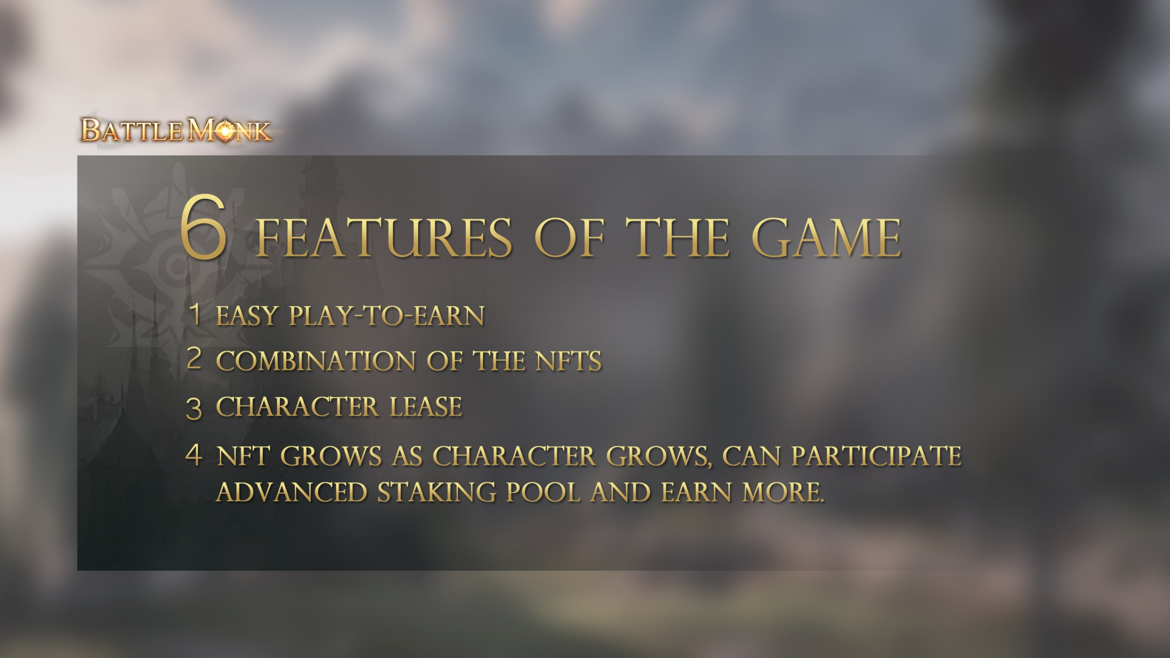
6. Features of the game
Easy play-to-earn
Combination of the NFTs
Character lease

Slide 23
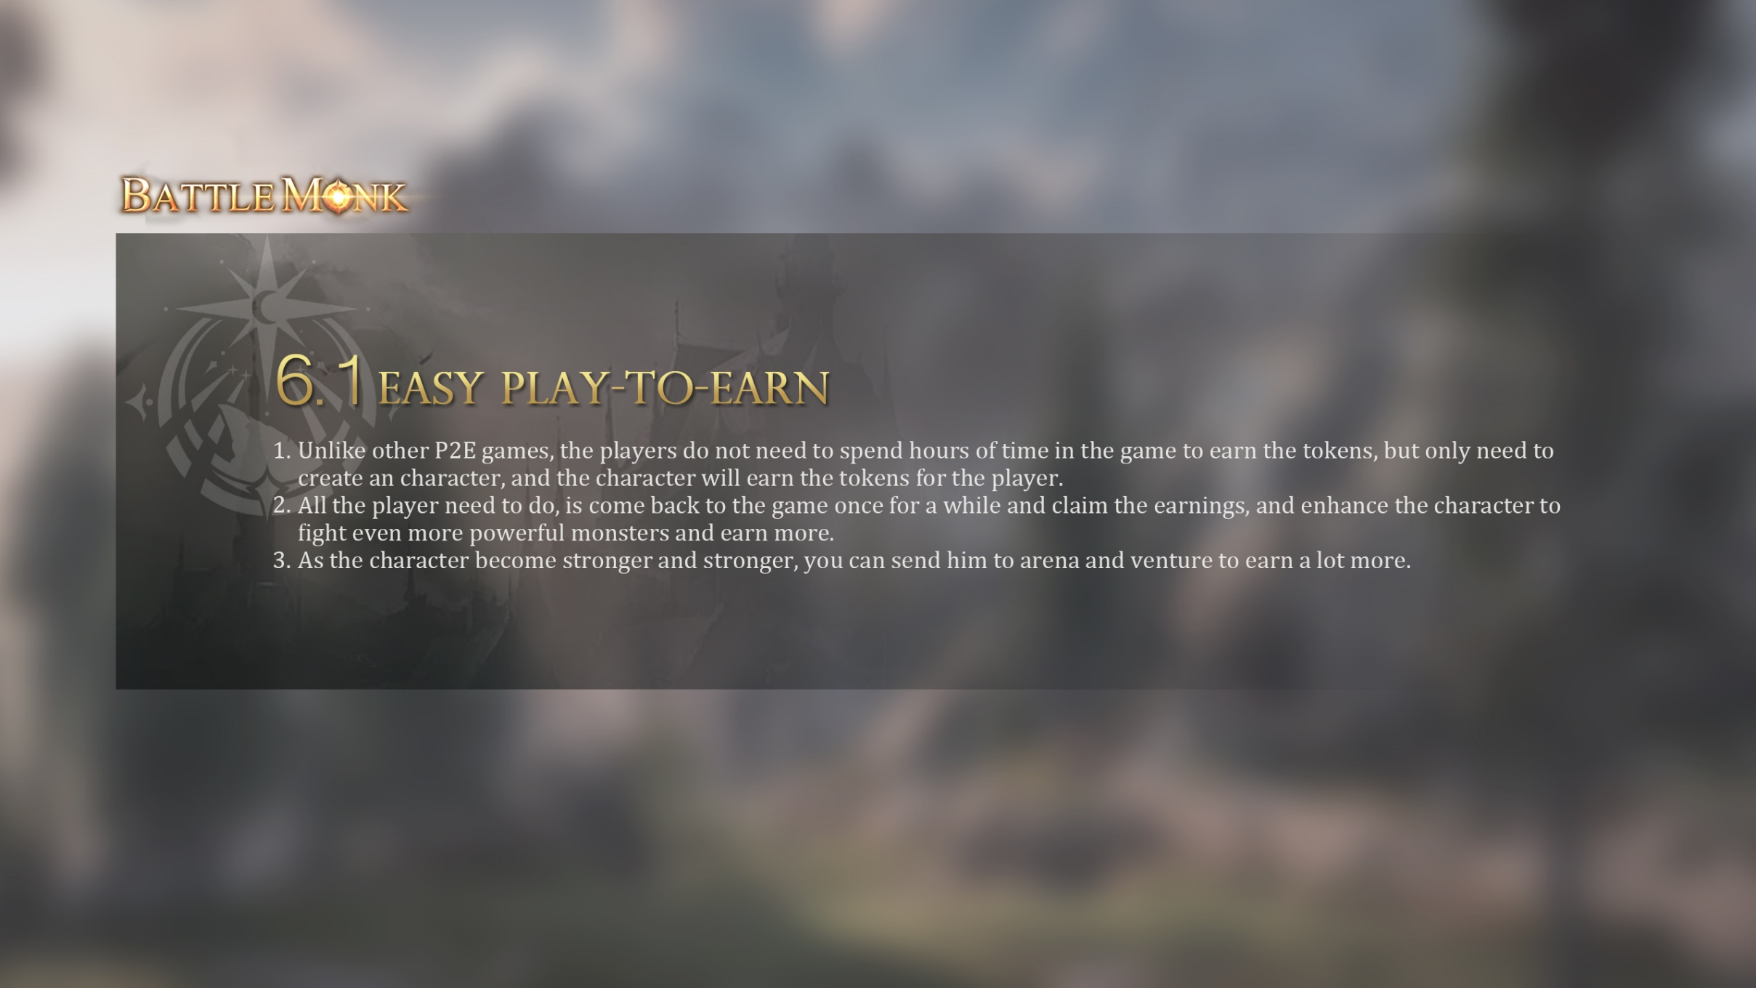
6.1 Easy play-to-earn
Unlike other P2E games, the players do not need to spend hours of time in the game to earn the tokens, but only need to create an character, and the character will earn the tokens for the player.
All the player need to do, is come back to the game once for a while and claim the earnings, and enhance the character to fight even more powerful monsters and earn more.
As the character become stronger and stronger, you can send him to arena and venture to earn a lot more.

Slide 24
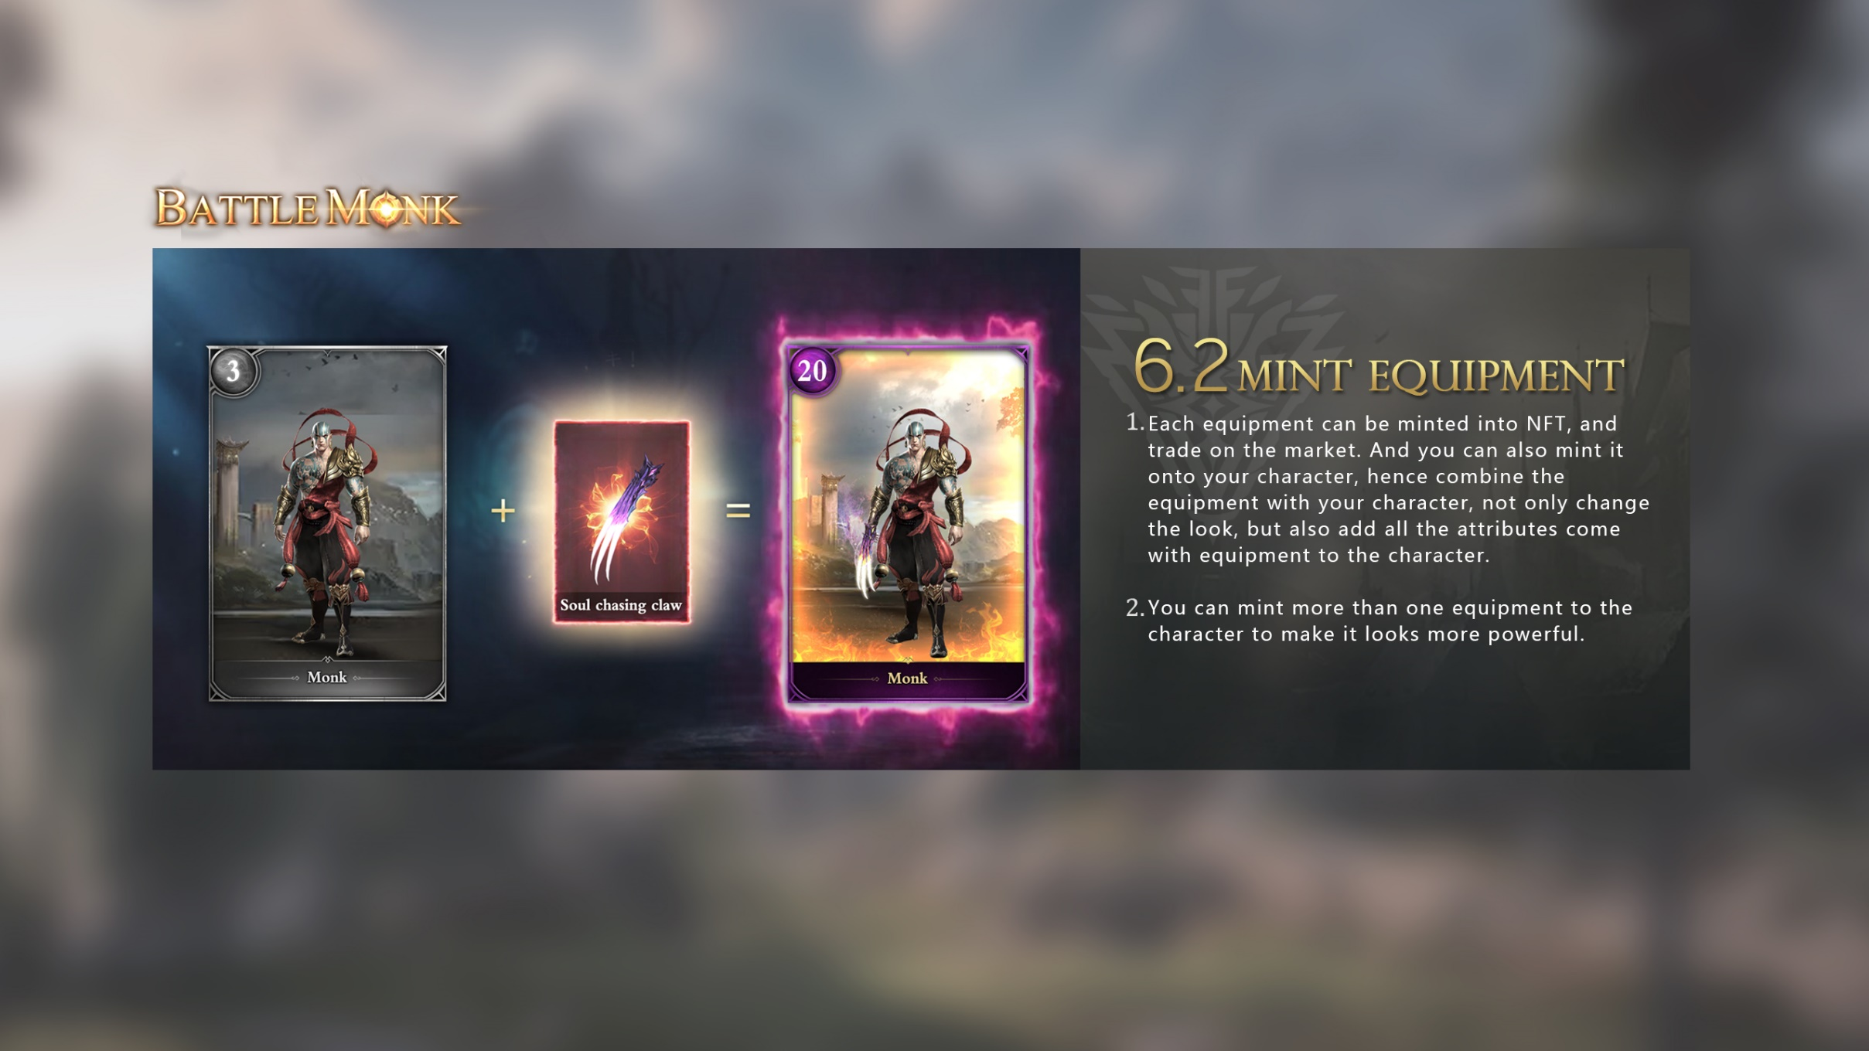
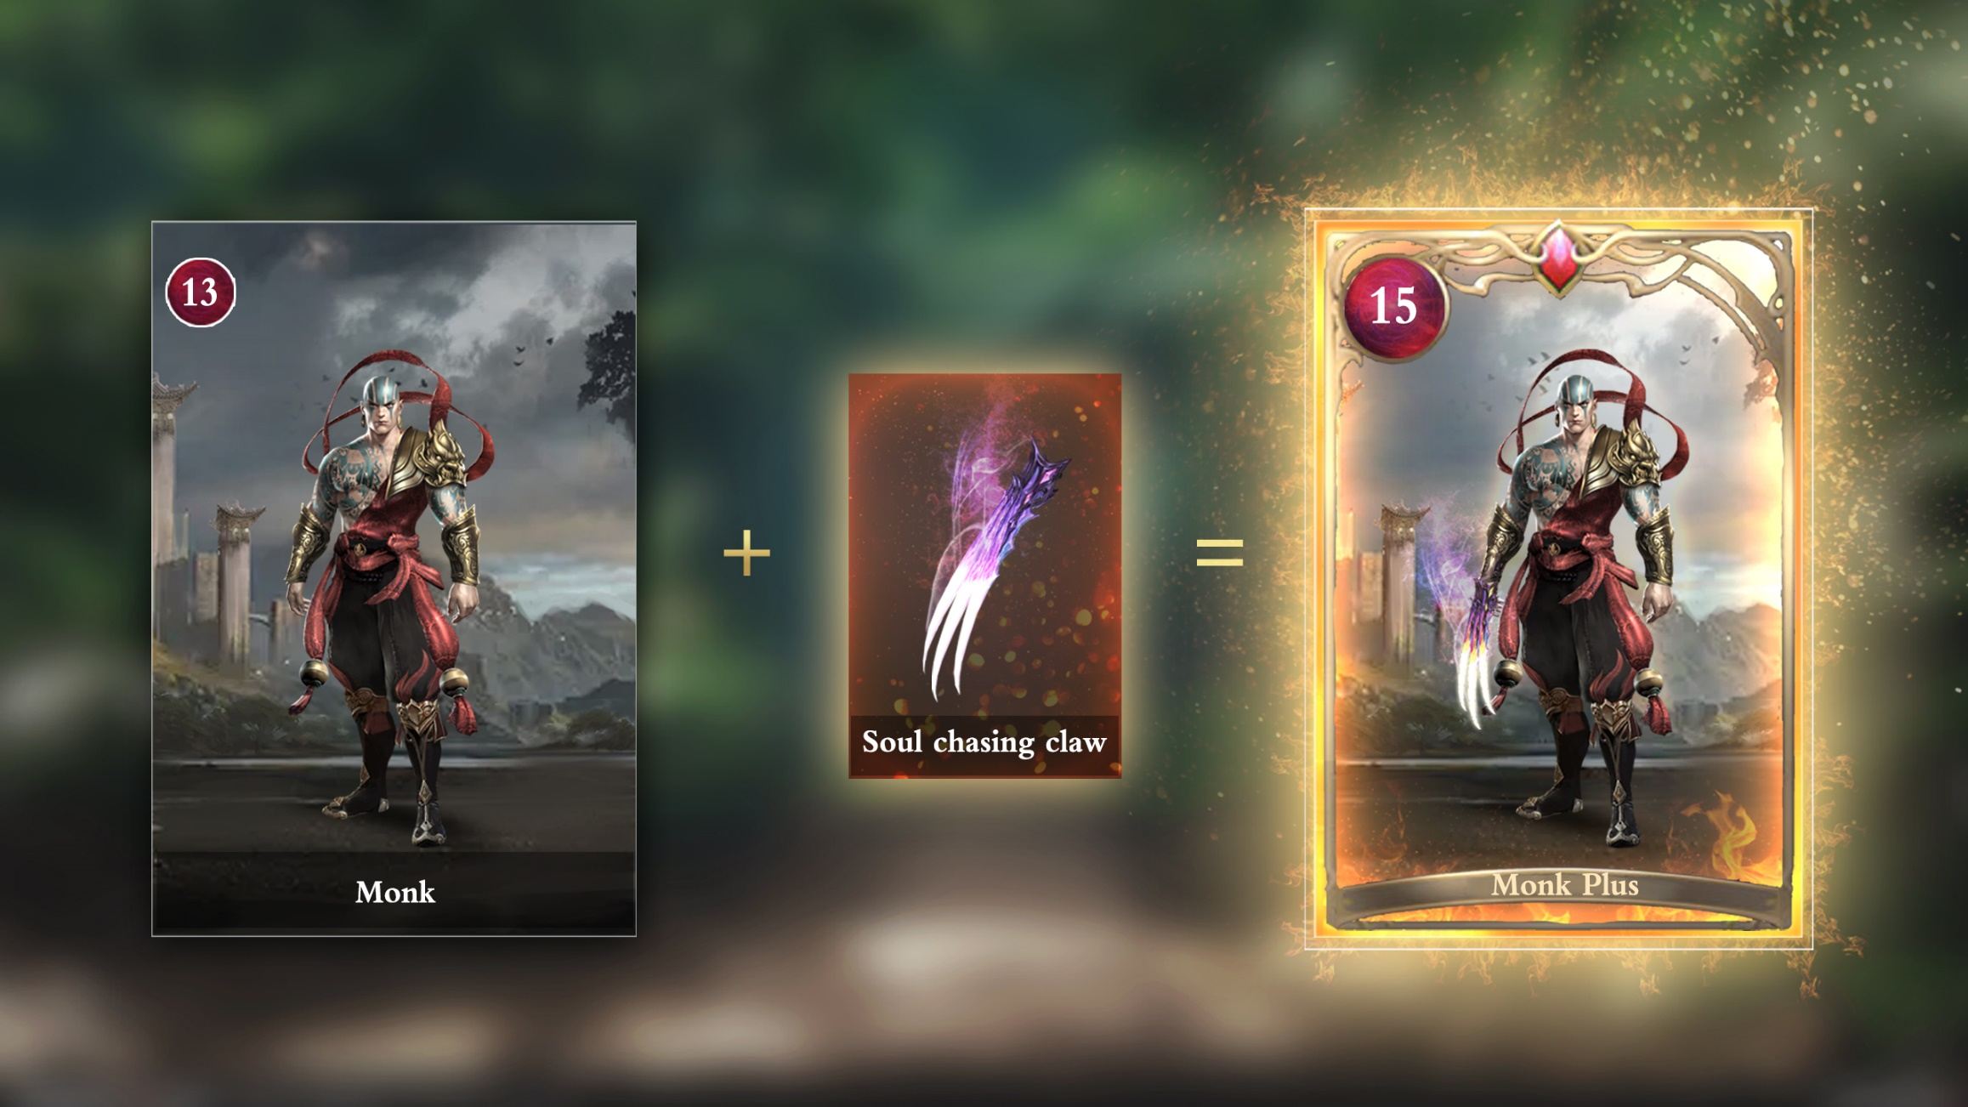
6.2 Mint equipment
Each equipment can be minted into NFT, and trade on the market. And you can also mint it onto your character, hence combine the equipment with your character, not only change the look, but also add all the attributes come with equipment to the character.
You can mint more than one equipment to the character to make it looks much more cooler.

Slide 25
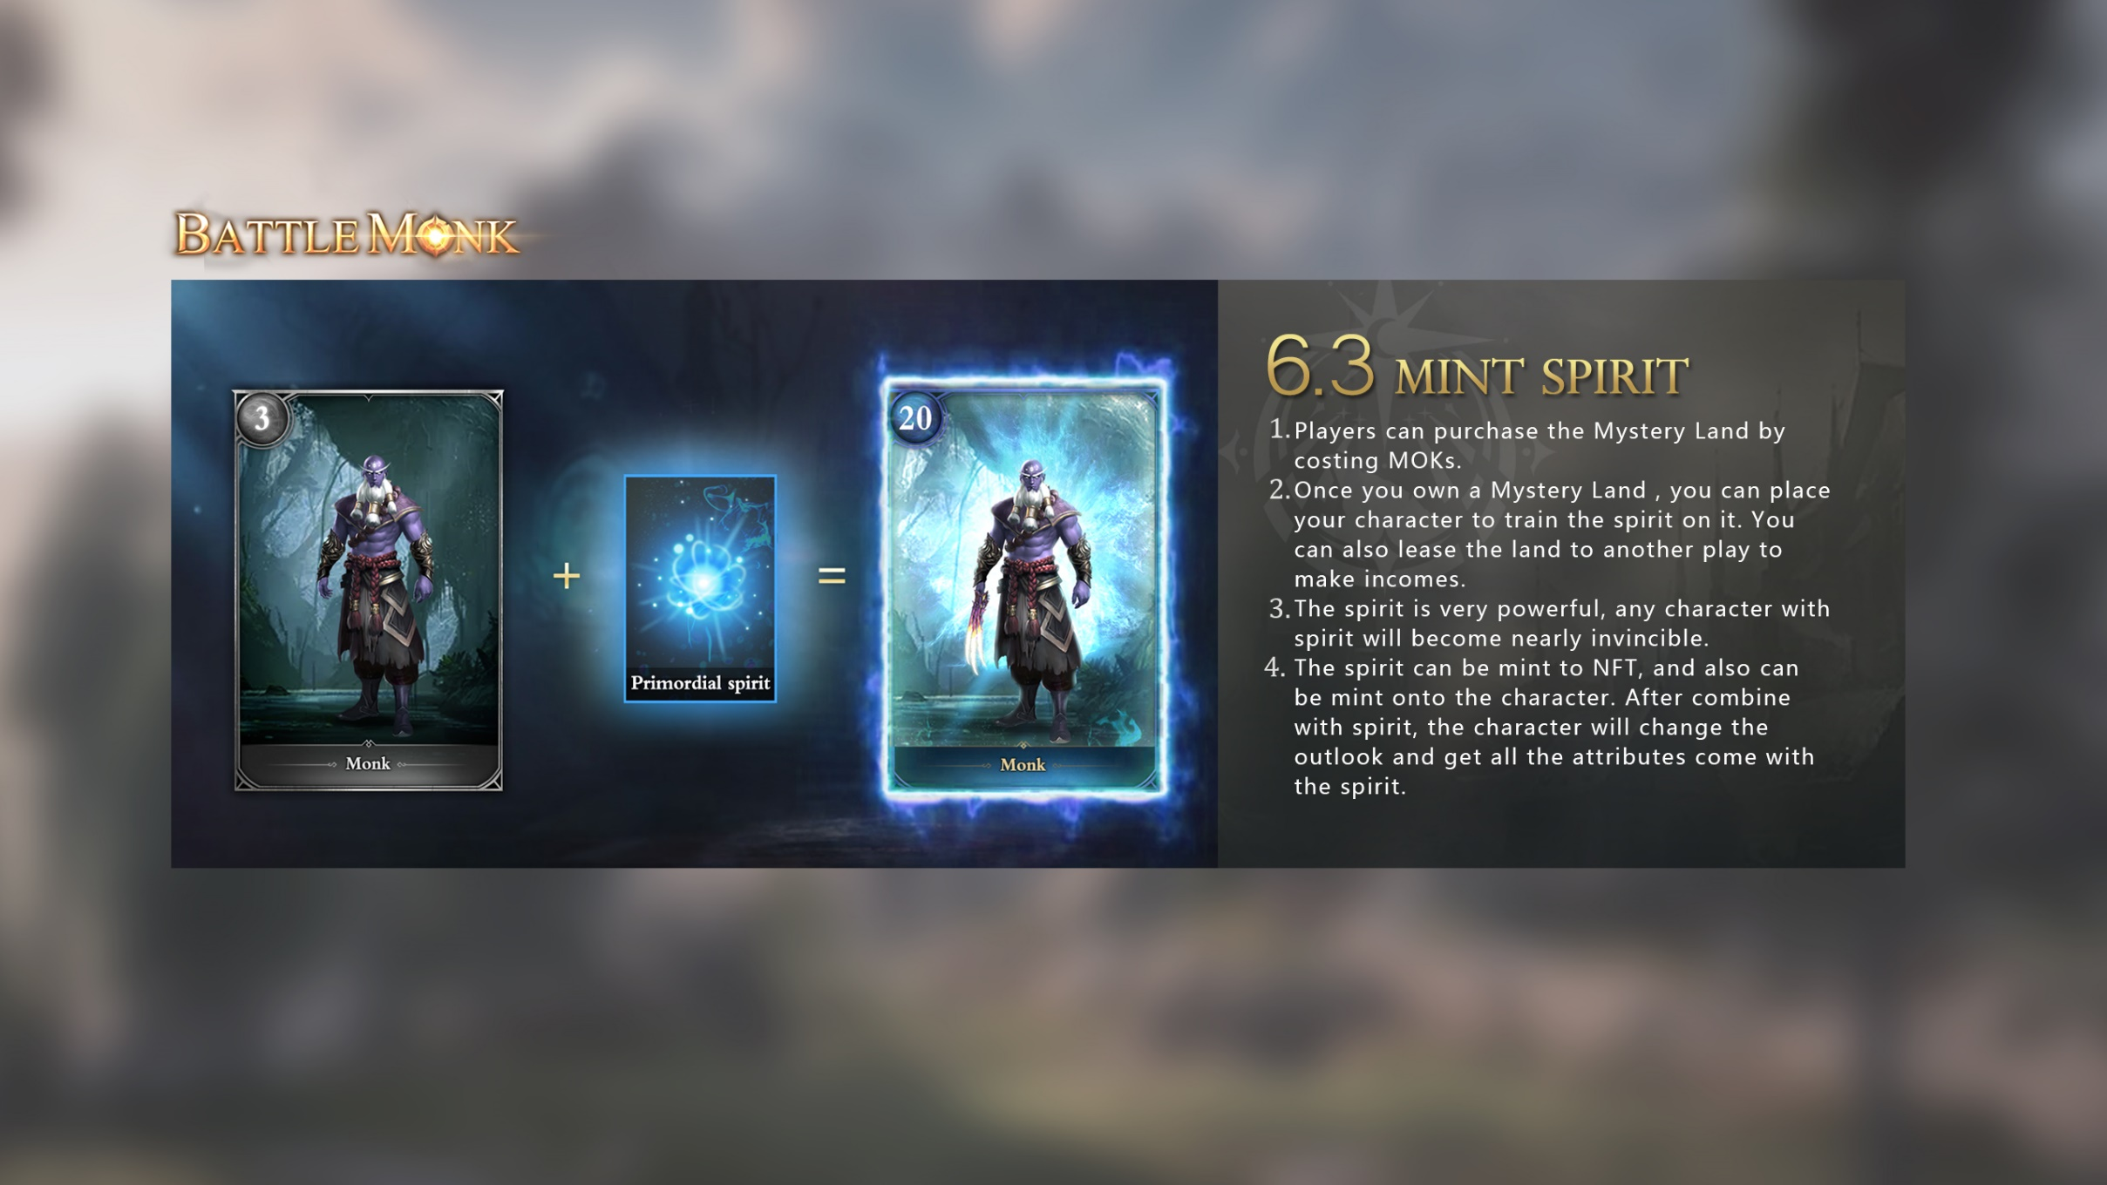
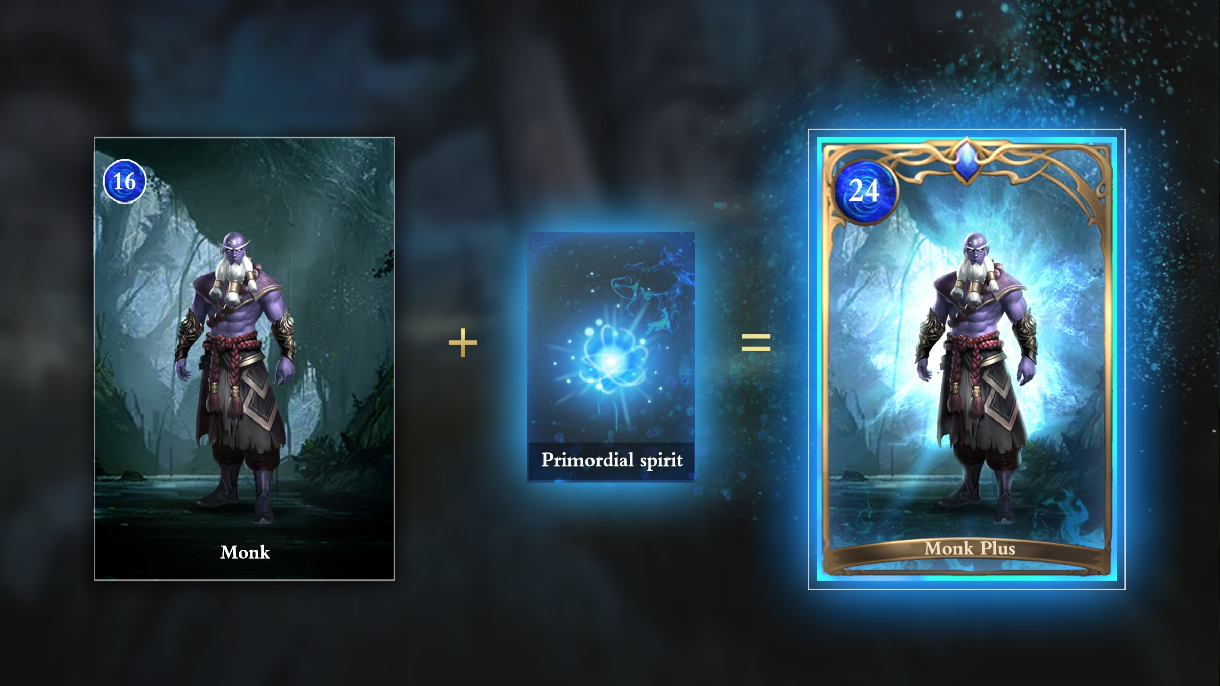
6.3 Mint spirit
Players can purchase the Mystery Land by costing MOKs.
Once you own a Mystery Land , you can place your character to train the spirit on it. You can also lease the land to another play to make incomes.
The spirit is very powerful, any character with spirit will become nearly invincible.
The spirit can be mint to NFT, and also can be mint onto the character. After combine with spirit, the character will change the outlook and get all the attributes come with the spirit.

Slide 26
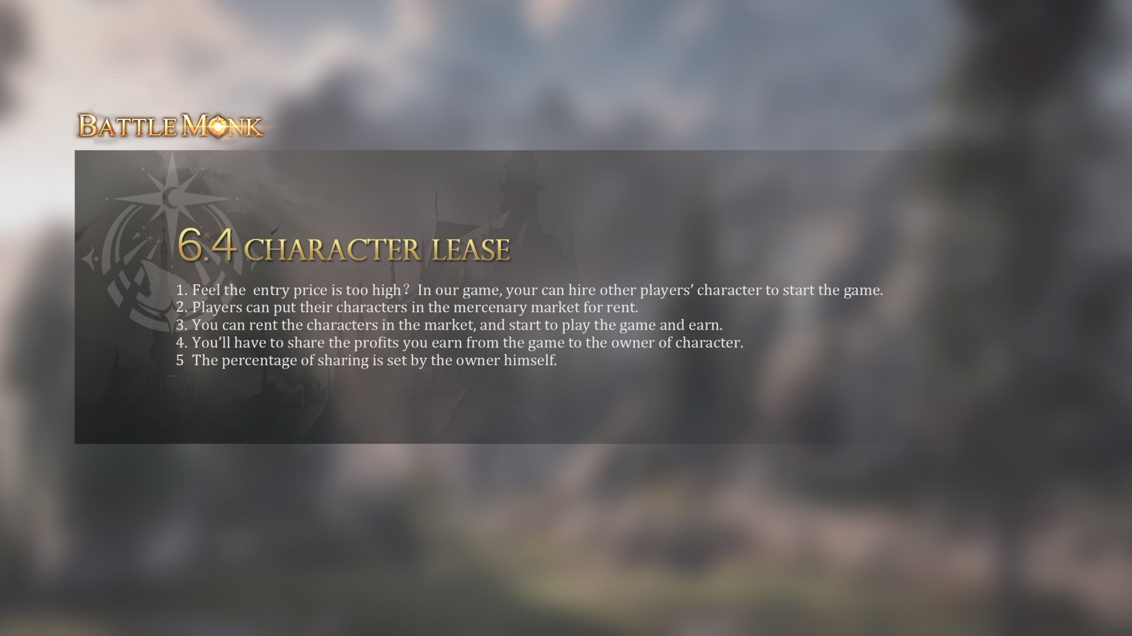
6.4 Character lease
Feel the entry price is too high？In our game, your can hire other players’ character to start the game.
Players can put their characters in the mercenary market for rent.
You can rent the characters in the market, and start to play the game and earn.
You’ll have to share the profits you earn from the game to the owner of character.
The percentage of sharing is set by the owner himself.

Slide 27
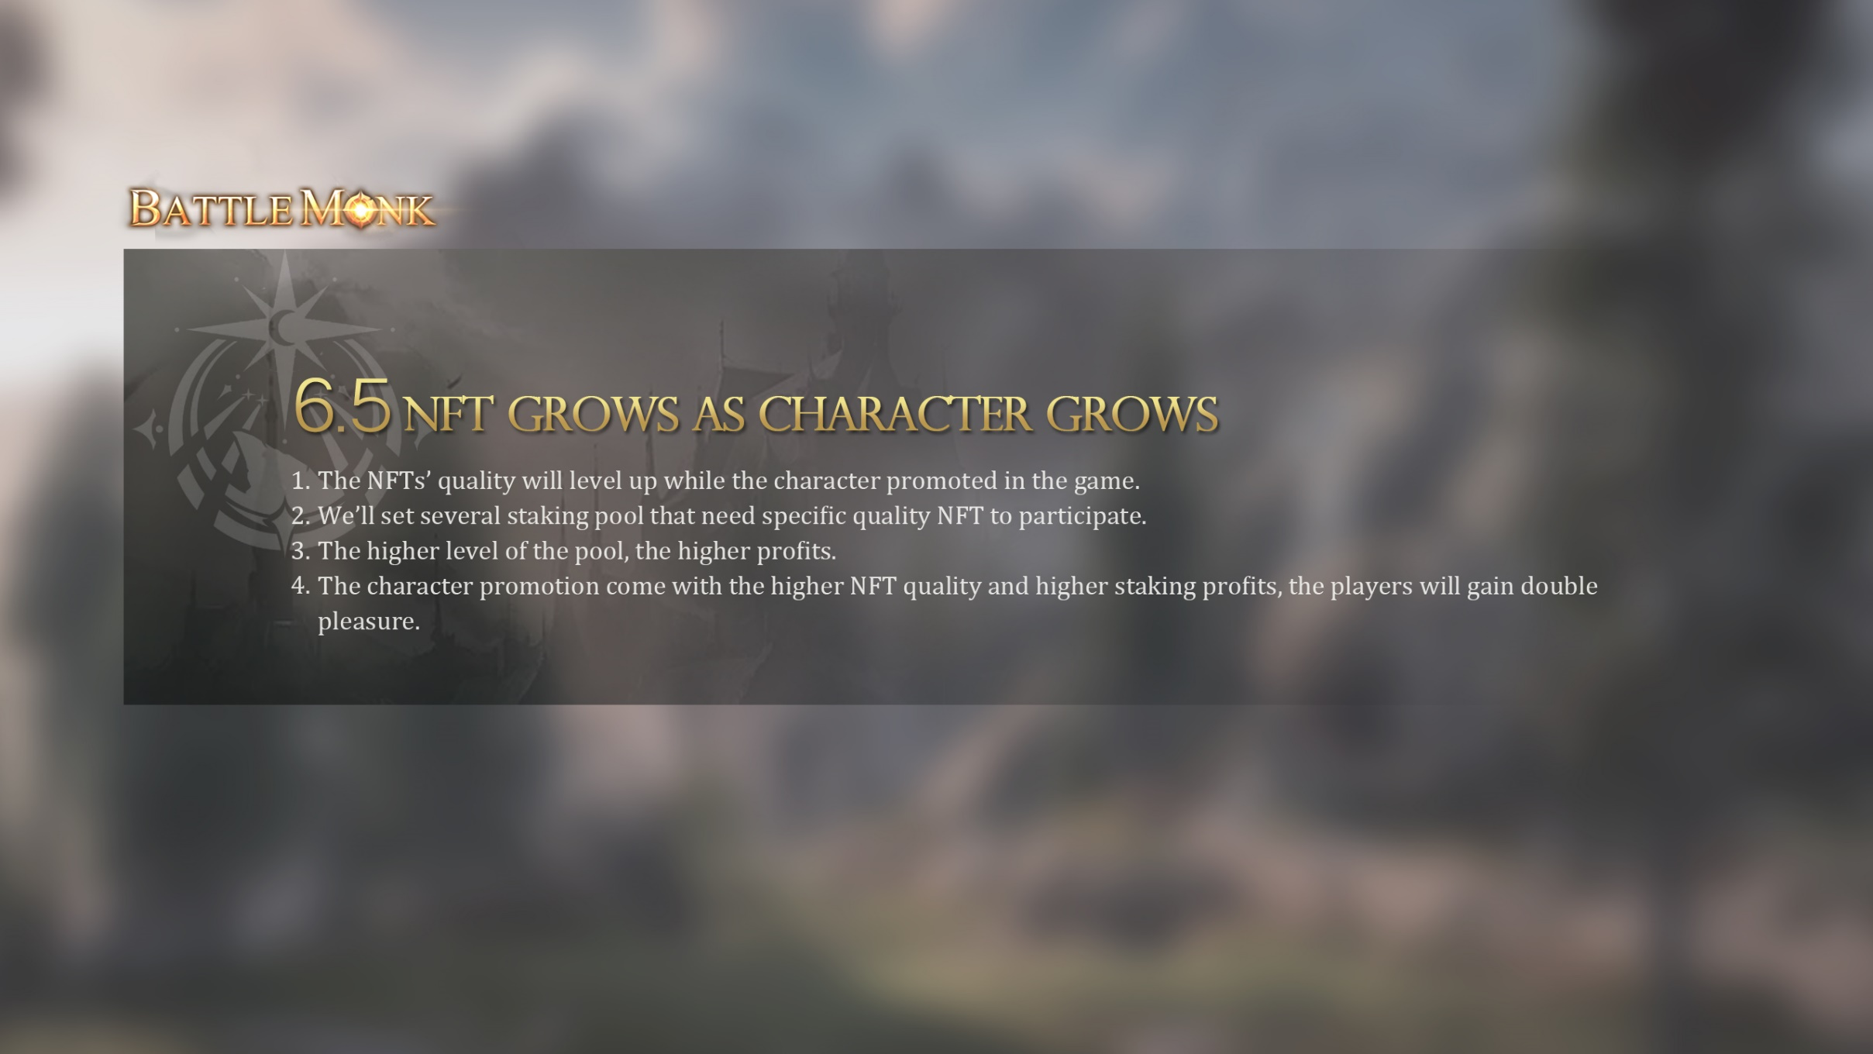
6.4 Character lease
Feel the entry price is too high？In our game, your can hire other players’ character to start the game.
Players can put their characters in the mercenary market for rent.
You can rent the characters in the market, and start to play the game and earn.
You’ll have to share the profits you earn from the game to the owner of character.
The percentage of sharing is set by the owner himself.

Slide 28
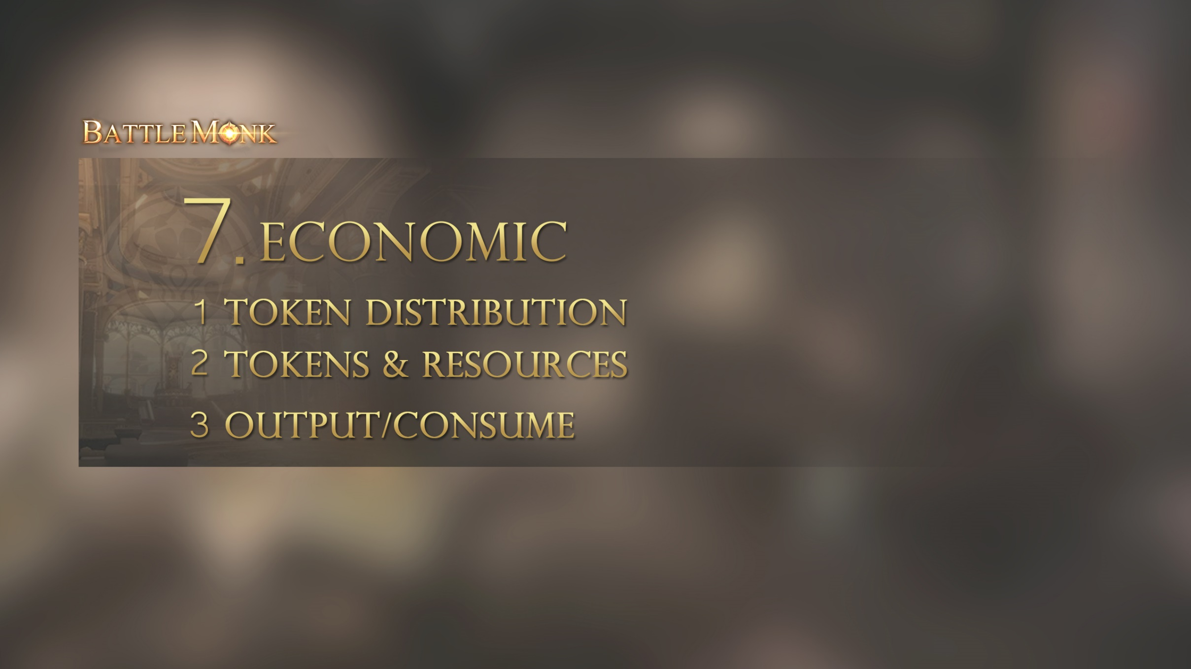
7. Economic

Slide 29
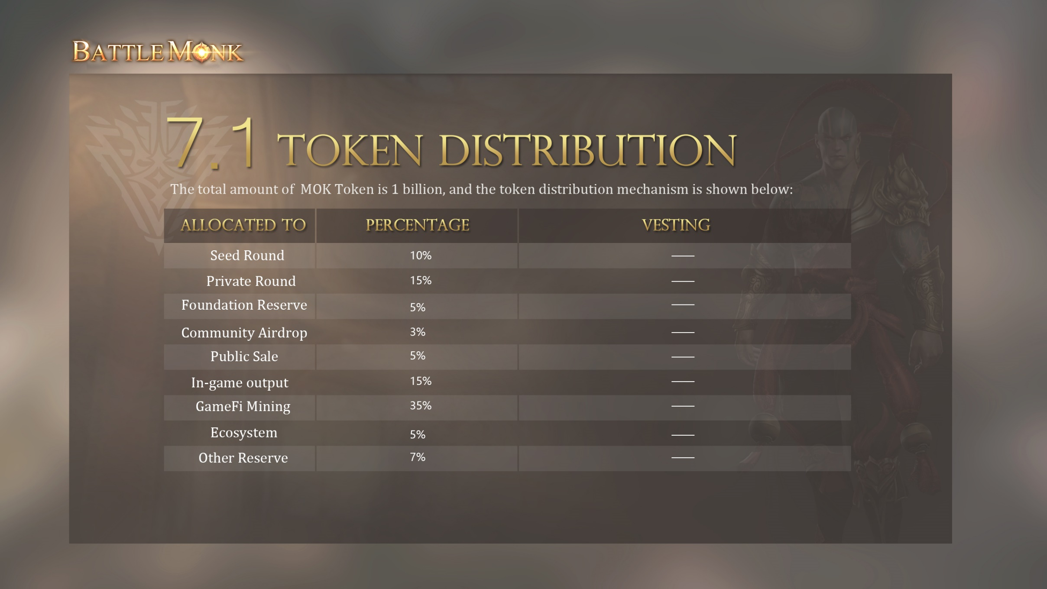
7.1 代币分配
The total amount of MOK Token is 1 billion, and the token distribution mechanism is shown below:
Allocated to | Percentage | Vesting
Seed Round | 10% | —
Private Round | 15% | —
Foundation Reserve | 5% | —
Community Airdrop | 3% | —
Public Sale | 5% | —
In-game output | 15% | —
GameFi Mining | 35% | —
Ecosystem | 5% | —
Other Reserve | 7% | —

Slide 30
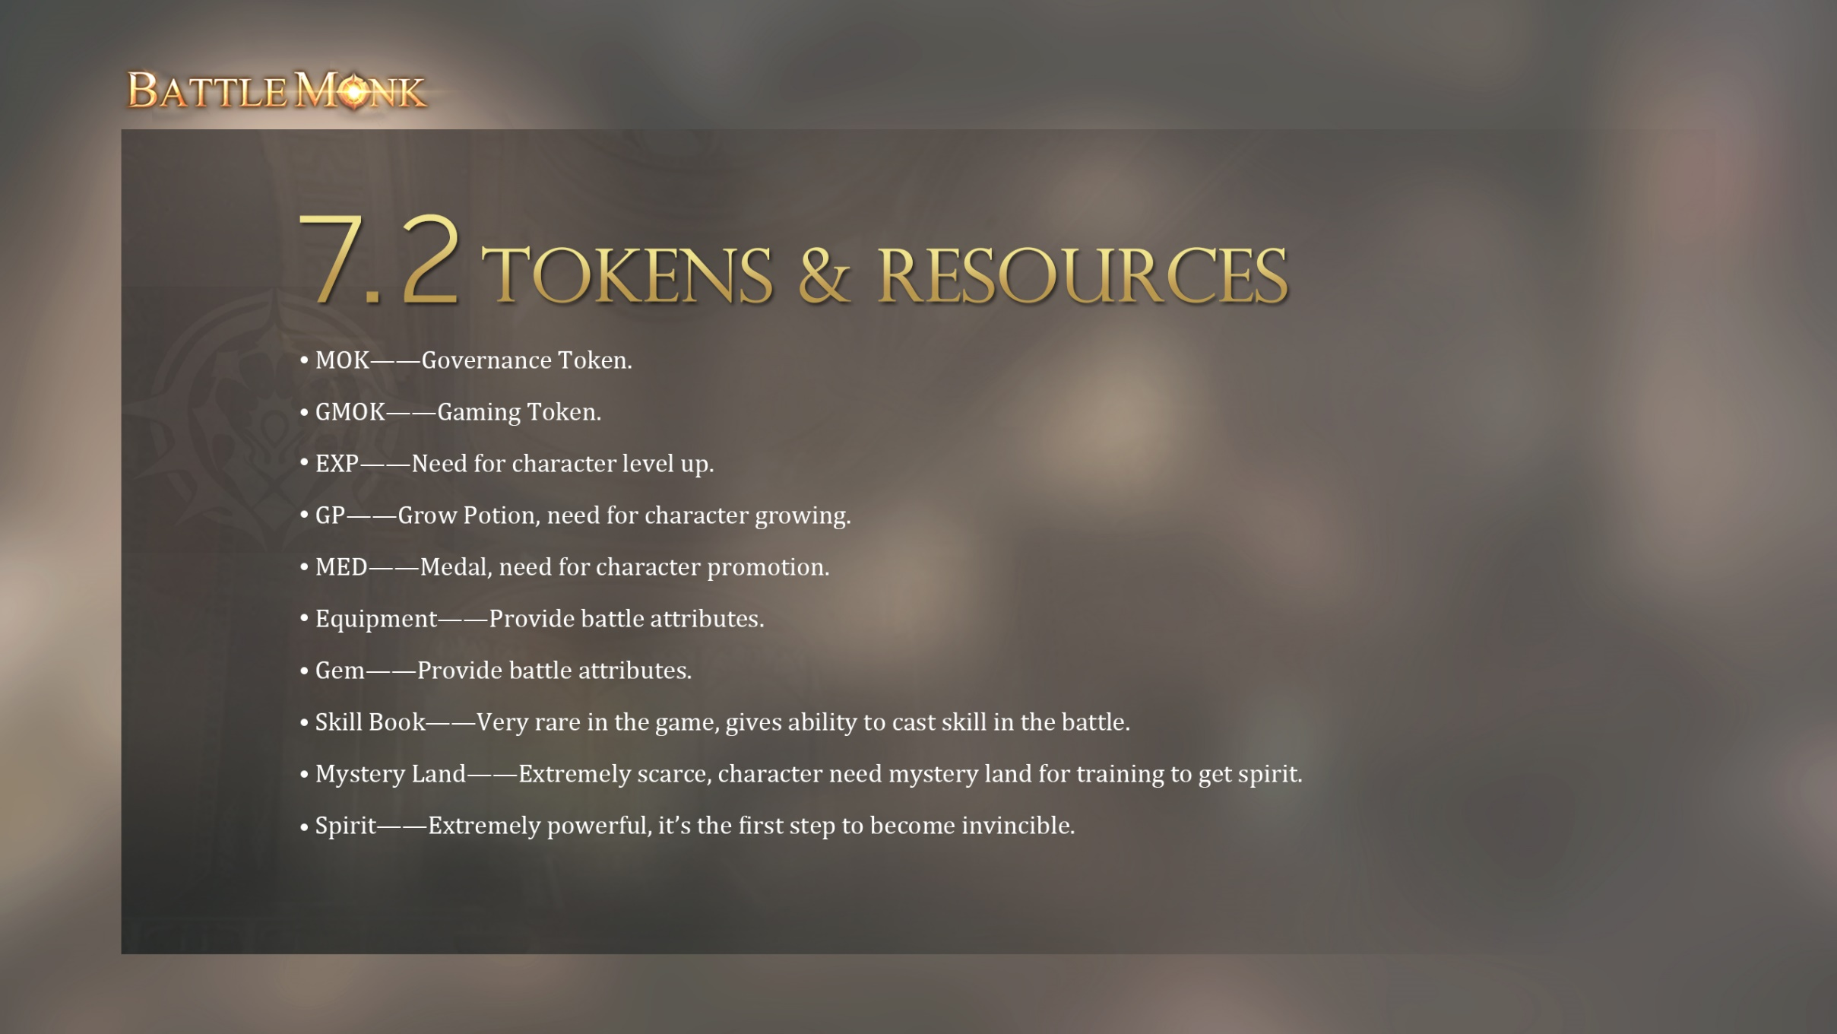
7.2 Tokens & Resources
MOK——Governance Token.
GMOK——Gaming Token.
EXP——Need for character level up.
GP——Grow Potion, need for character growing.
MED——Medal, need for character promotion.
Equipment——Provide battle attributes.
Gem——Provide battle attributes.
Skill Book——Very rare in the game, gives ability to cast skill in the battle.
Mystery Land——Extremely scarce, character need mystery land for training to get spirit.
Spirit——Extremely powerful, it’s the first step to become invincible.

Slide 31
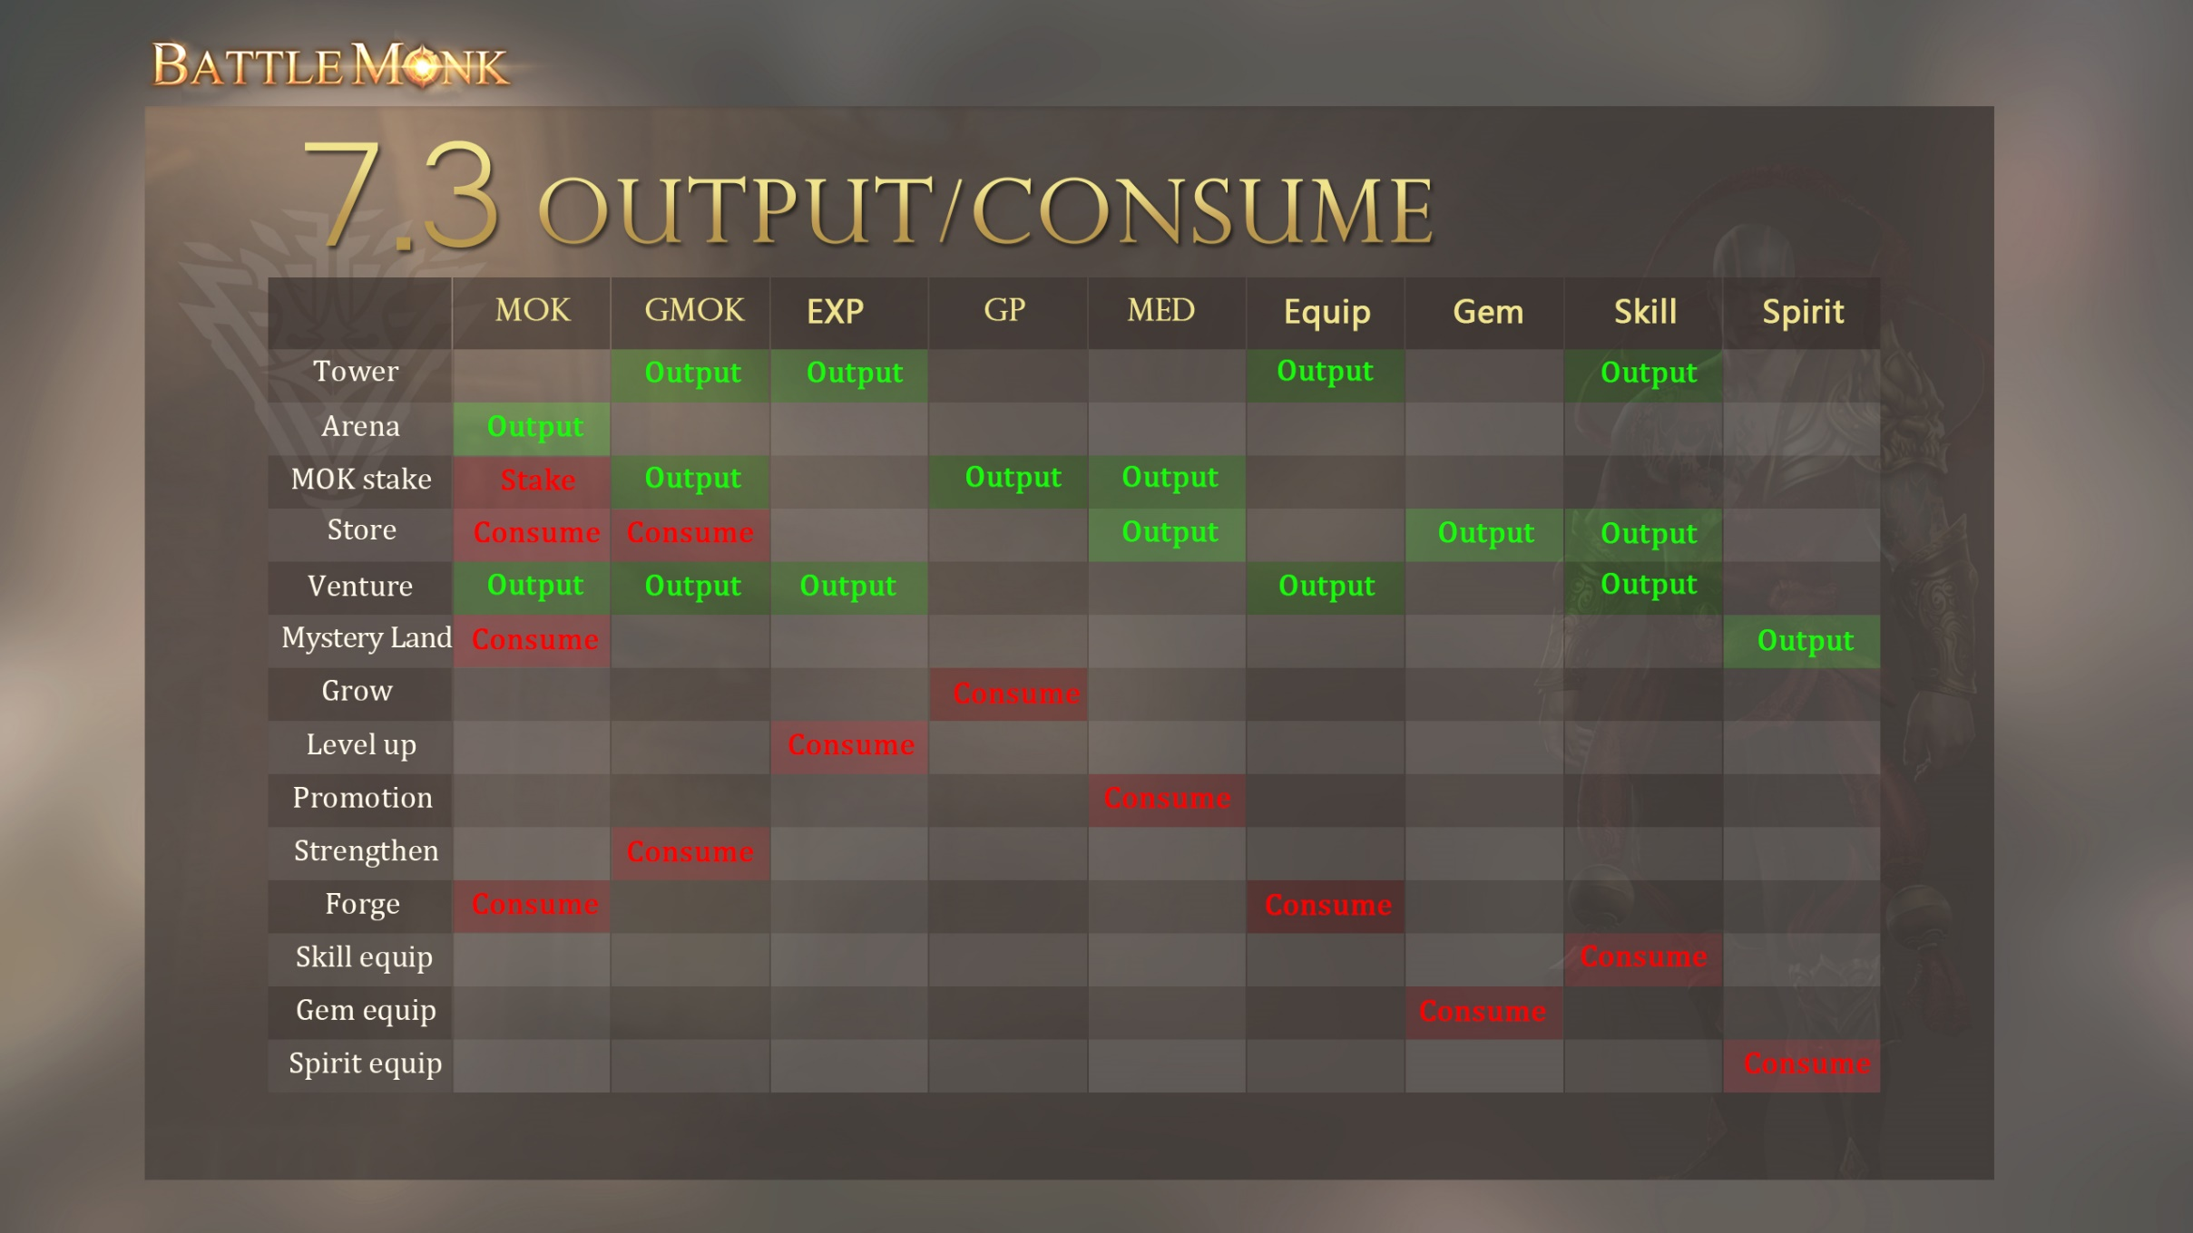
7.3 Output/Consume

